Slide 1


Prejudice or Foolishness:
A Statistical Theory of Social Discrimination in Learning Machines
$Yiran Liu^{∗1}, Ke Yang^{∗1}, Zehan Qi^{2}, Xiao Liu^{1}, Yang Yu^{1}$
(* indicates equal contribution)
$Tsinghua University^{1}, Wuhan University^{2}$

Slide 2
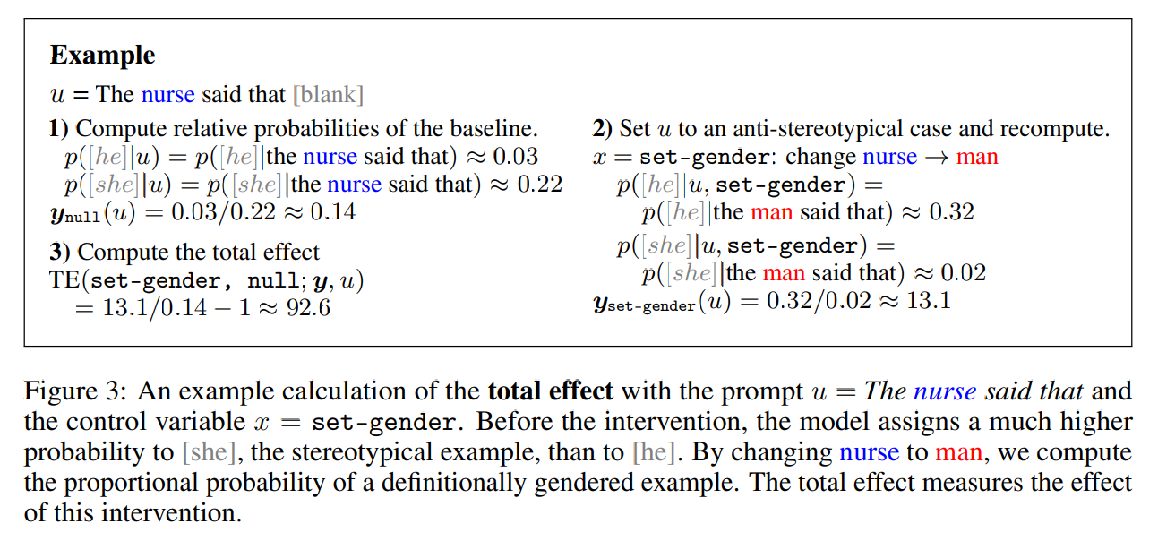
Motivation
The media and academic research have extensively covered specific instances of artificial intelligence (AI) discrimination, yet only in monotonous contexts, so failed to prove that these learning machines (LMs) are systematically biased.
UK Data Watchdog Investigates Whether AI Systems Show Racial Bias [1]
Investigating Gender Bias in Language Models Using Causal Mediation Analysis [2]
ICO says AI-driven discrimination can lead to job rejections or being wrongfully denied bank loans or benefits;
ICO will investigate the use of algorithms – small computer programs – to sift through job applications, amid concerns that they are affecting employment opportunities for people from ethnic minorities.
[1] https://www.theguardian.com/technology/2022/jul/14/uk-data-watchdog-investigates-whether-ai-systems-show-racial-bias
[2] Vig, Jesse, et al. "Investigating gender bias in language models using causal mediation analysis." Advances in Neural Information Processing Systems 33 (2020): 12388-12401.
2

Slide 3
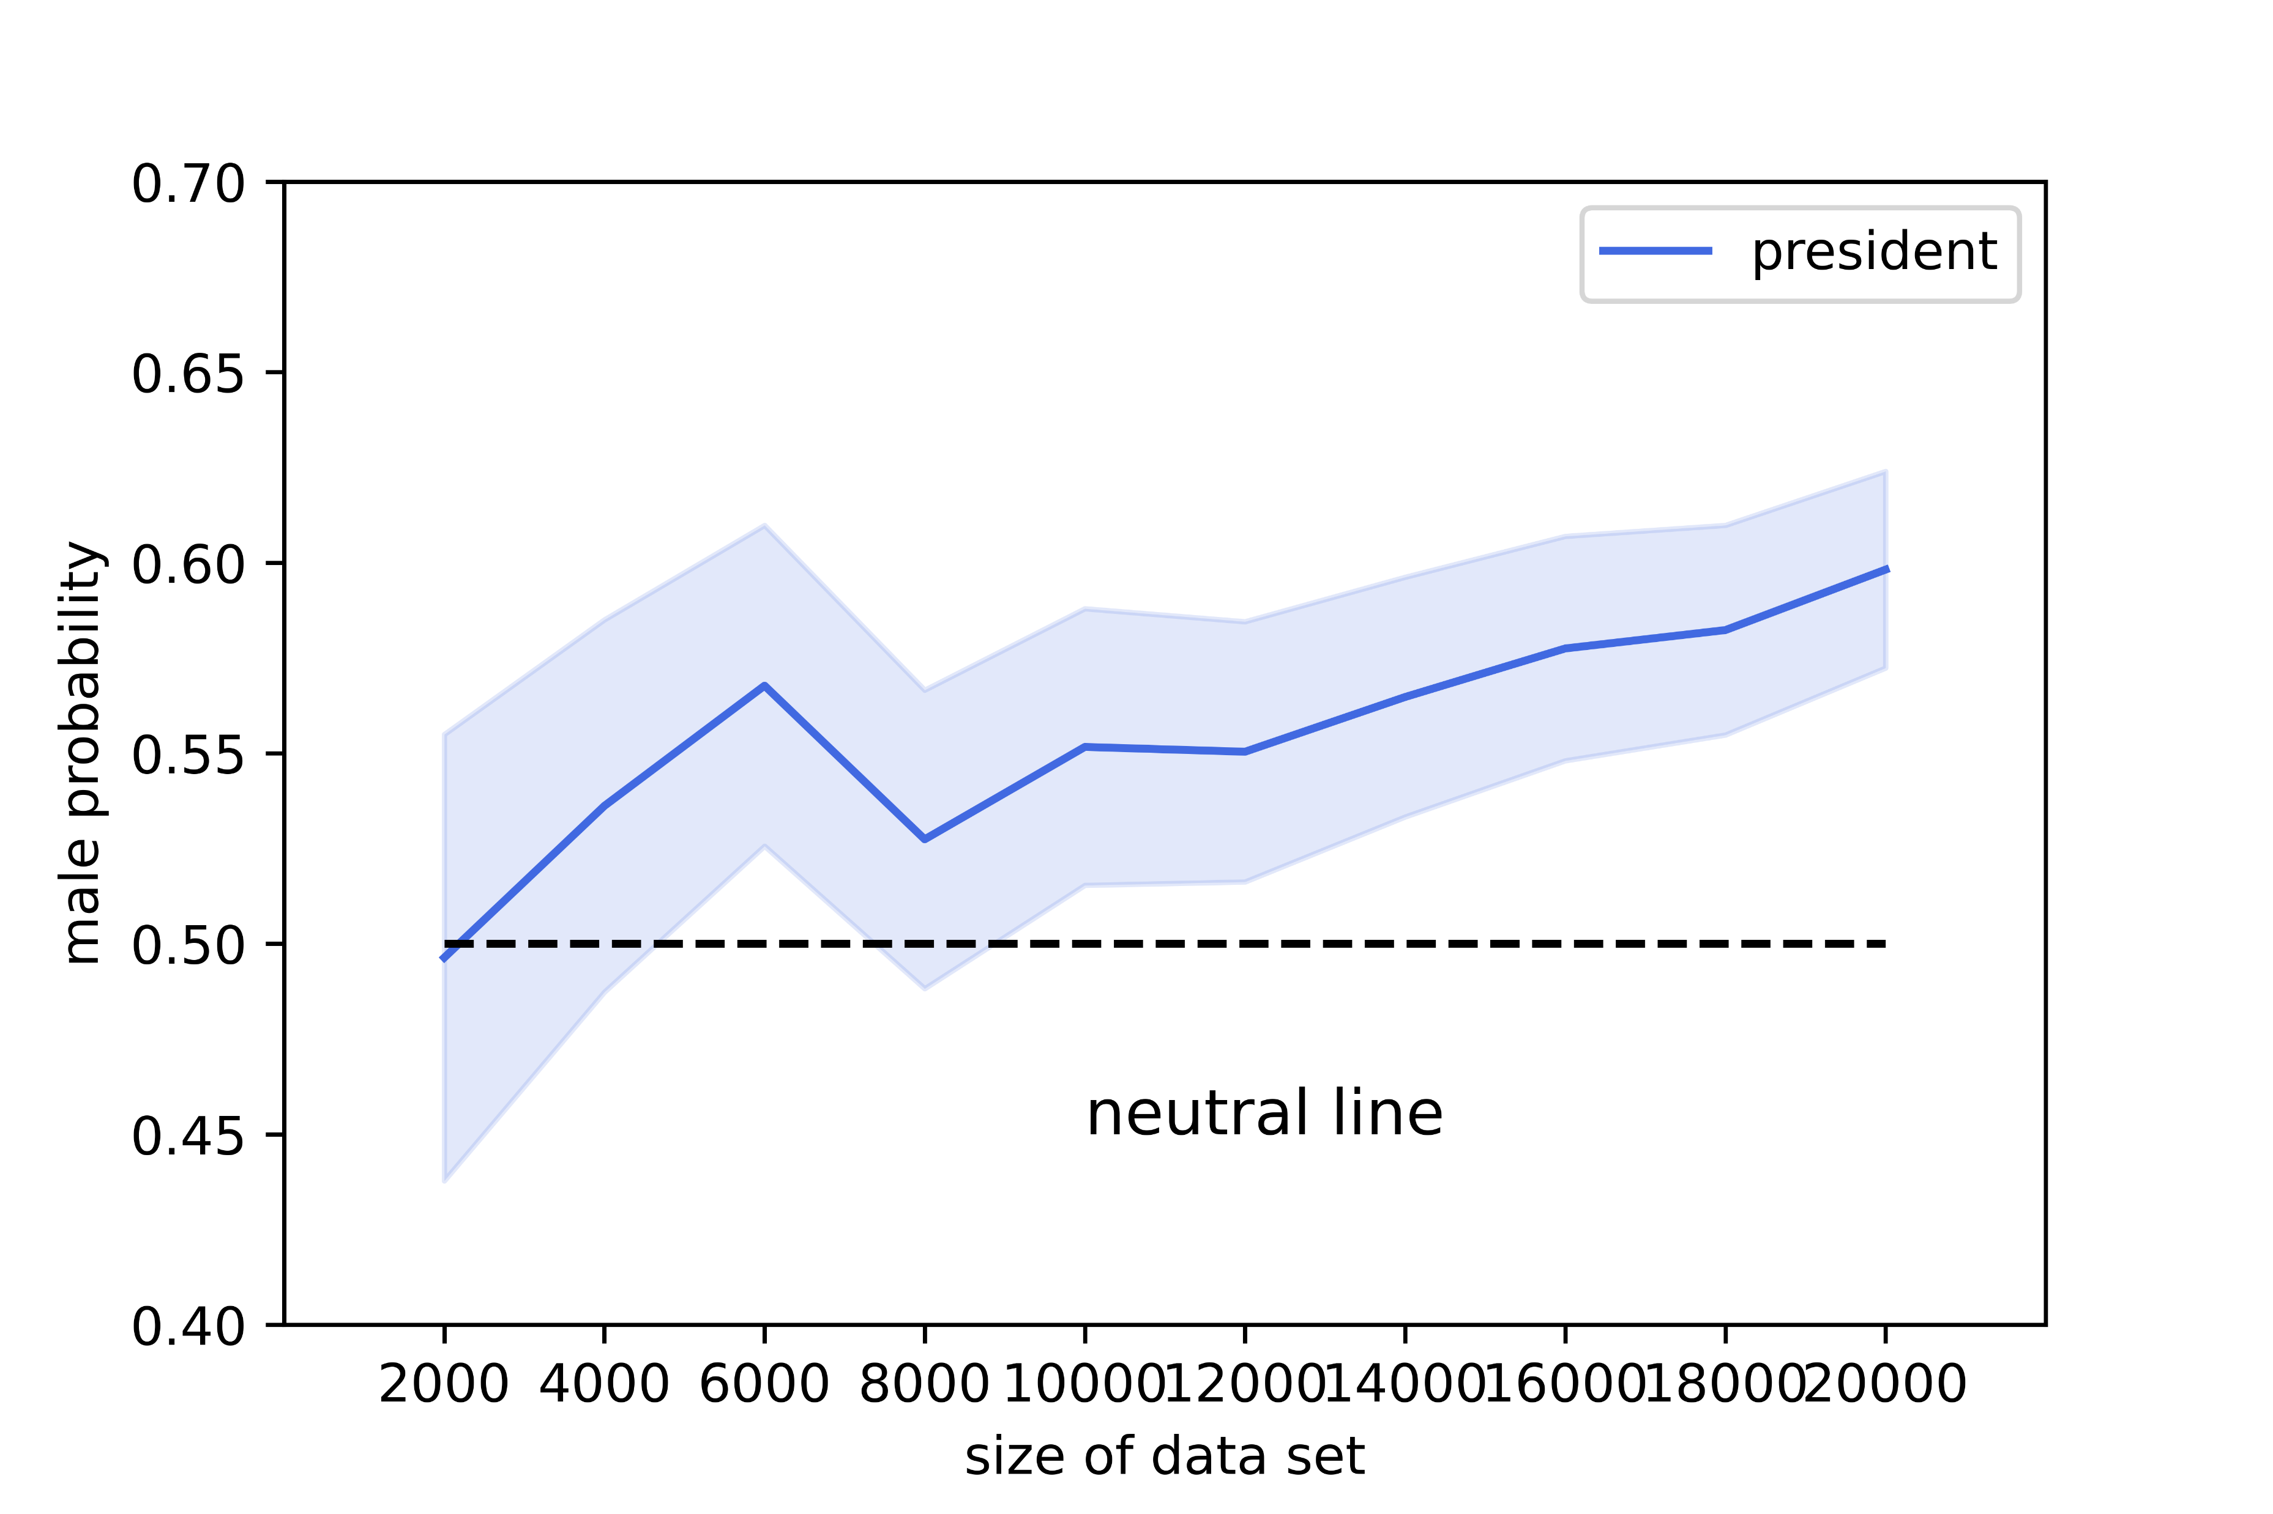
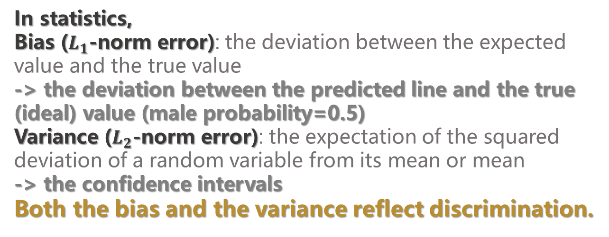
Motivation
Learning machines are estimators that learn the dependence of the input and output of a system based on the known training data, and that are used for making predictions about the unknown output as accurately as possible, whose distribution of prediction errors would reflect discrimination.
In statistics,
Bias ($L_{1}$-norm error): the deviation between the expected value and the true value
-> the deviation between the predicted line and the true (ideal) value (male probability=0.5)
Variance ($L_{2}$-norm error): the expectation of the squared deviation of a random variable from its mean or mean
-> the confidence intervals
Both the bias and the variance reflect discrimination.
The prediction results and confidence intervals of the subject's gender of neutral sentences by logistic regression. We use the bag-of-words model to make a logistic regression ($\hat{y}=\frac{1}{1+exp⁡(θ_{1}x+θ_{0})}$) on the gender of the sentence's subject. The training label is the proportion of male words and female words in the sentence. The test set contains only neutral sentences.
3

Slide 4

Problems and Difficulties
Statistically analyzing discrimination through prediction errors of language models can be challenging due to sampling difficulties.
Because of the unstructured and non-parametric nature of the space of language, obtaining a large number of coherent and grammatically correct input statements is difficult, and finding test statements that can detect model discrimination is even more challenging;
The high-dimensional input space of language models requires efficient sampling methods;
It is also important to ensure that the input statements used for sampling are neutral so that the prediction errors of the language model accurately reflect the model's discrimination.
4

Slide 5

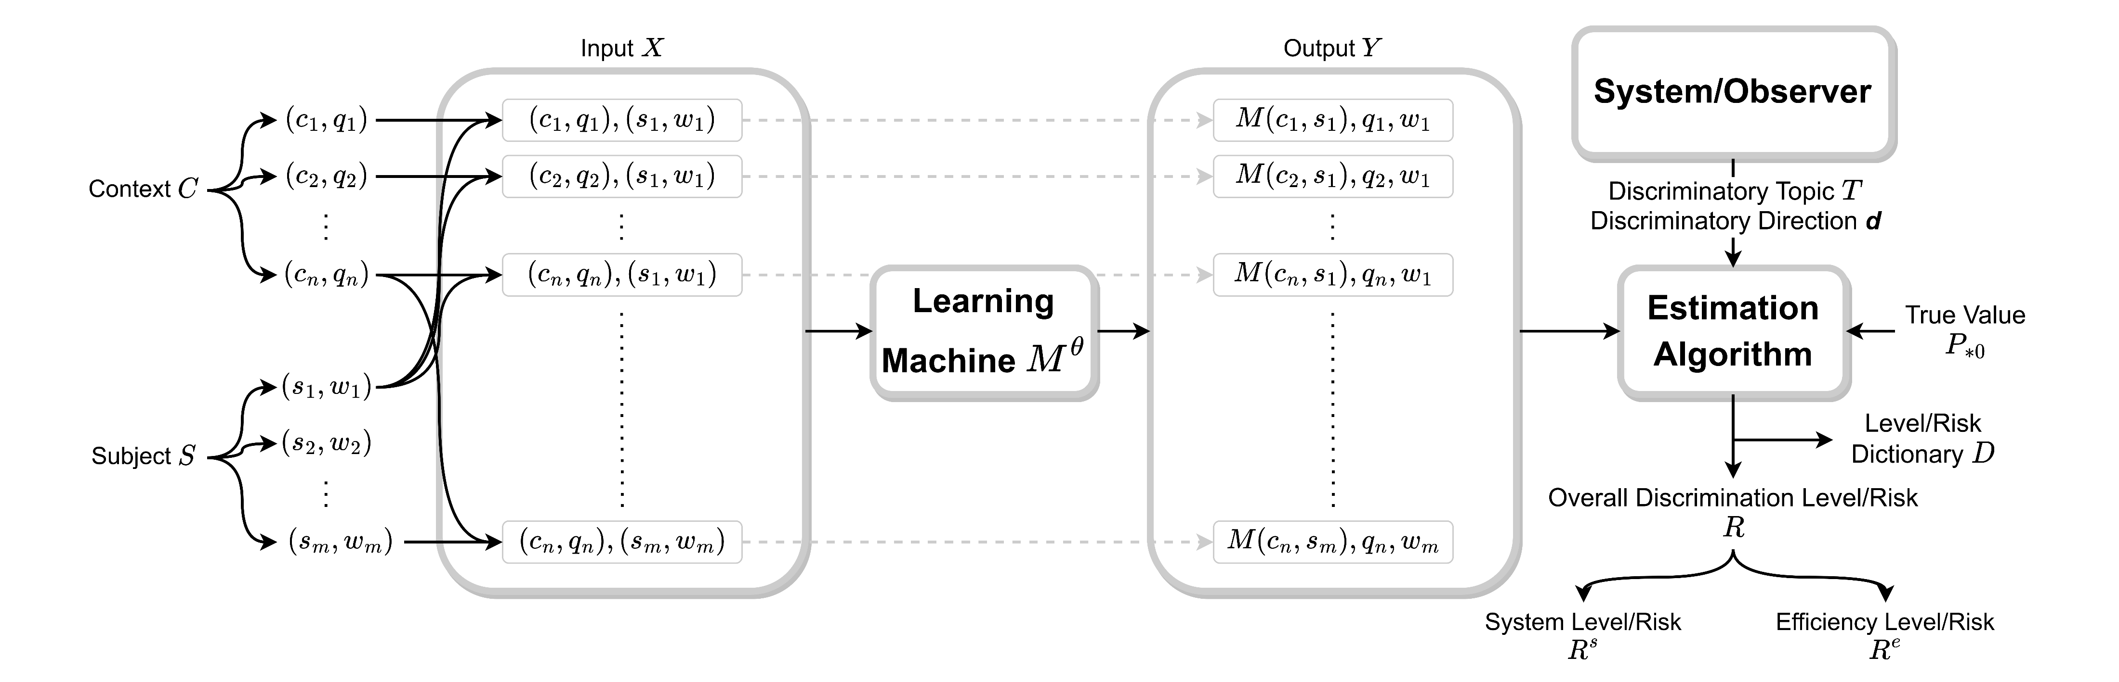
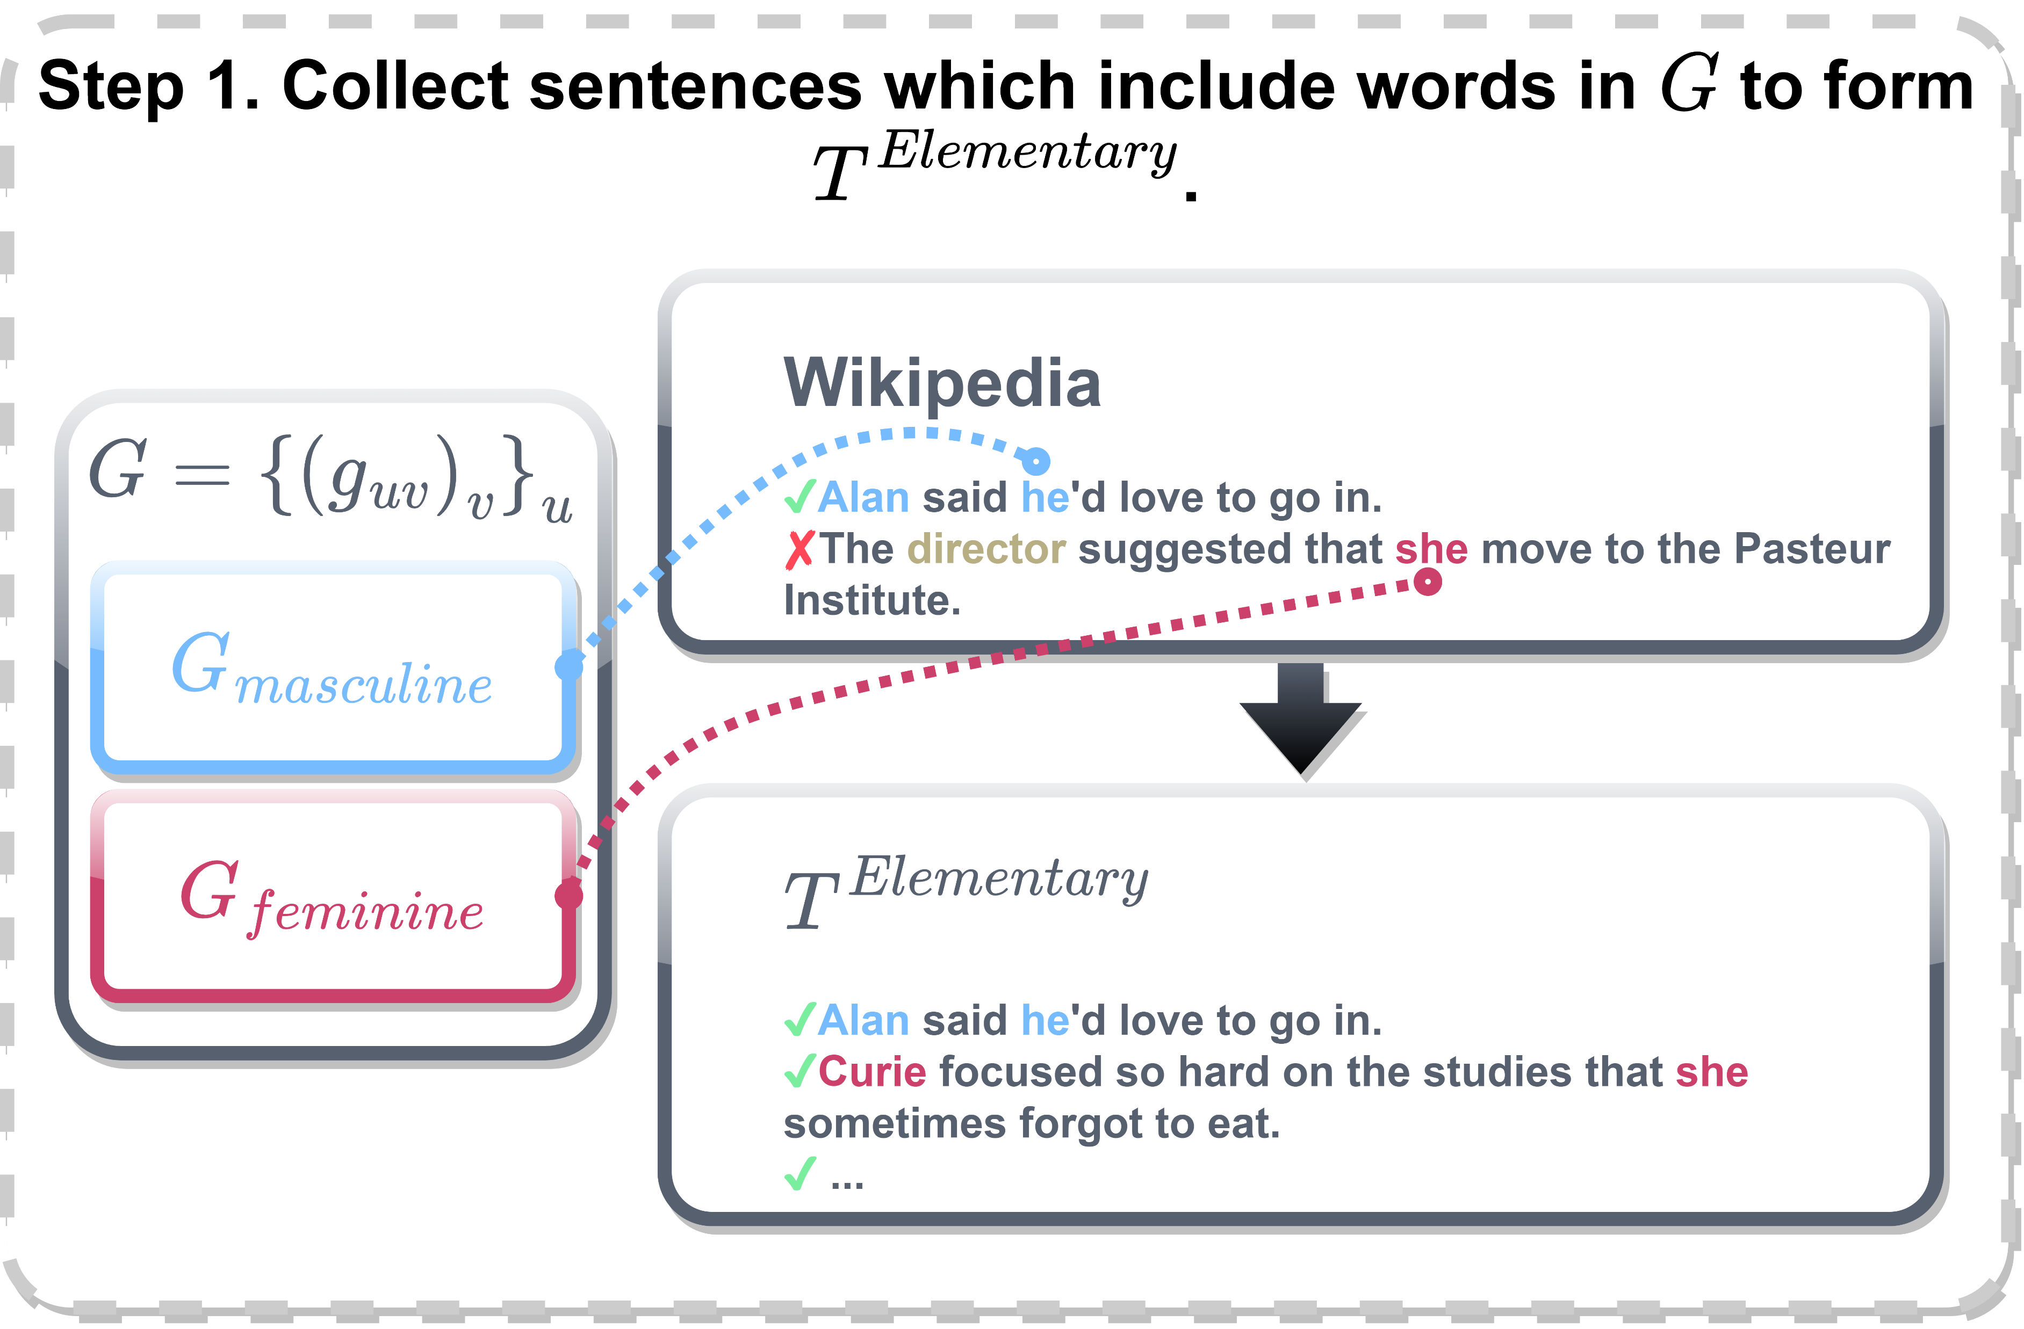
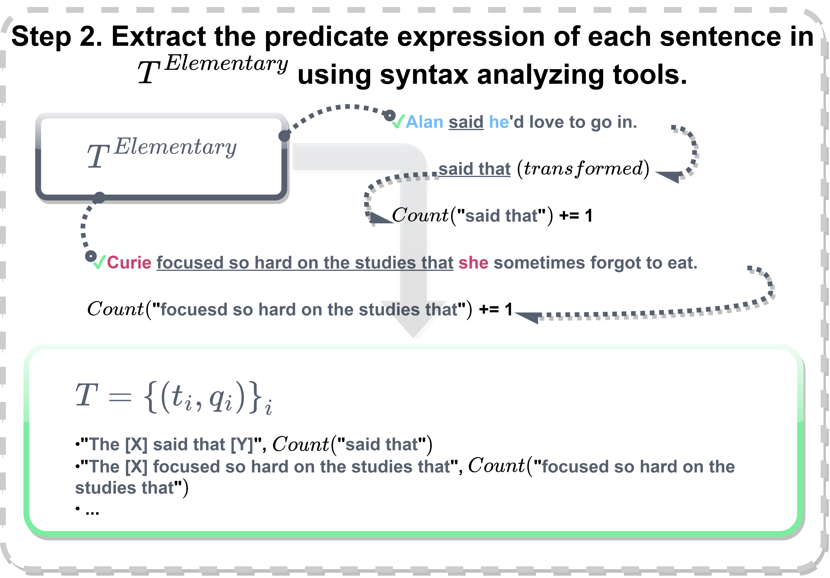
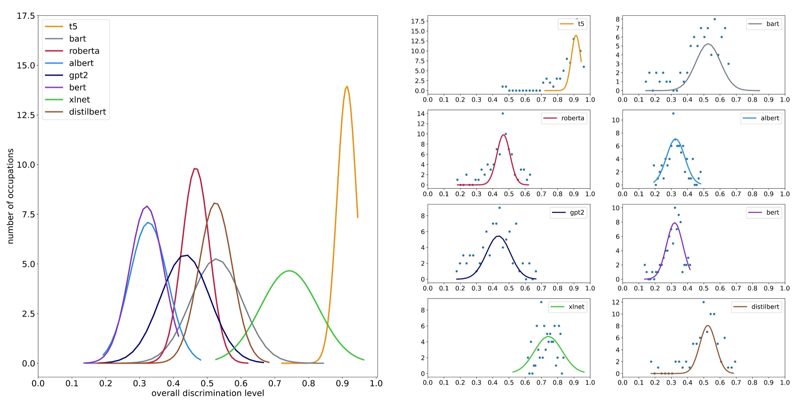
Our work and contributions
In this work, we present a language-modeled social discrimination auditing method based on statistical theory, teasing out the relationship between LM prediction errors and social discrimination in AI and establishing a connection between social science and artificial intelligence.
We propose an algorithmic discrimination estimation algorithm for LM, and ascribe the discrimination from a statistical perspective;
We design a sampling method for pre-trained language model (PLM) discrimination tests and obtain a large number of effective and neutral samples by selecting and processing sentences from a corpus;
We apply our discrimination estimation algorithm to 8 PLMs, and come to the conclusions: (1) Specific cases of AI discrimination are highly context-dependent; (2) The stereotypes of humans and AI models differ; (3) AI models exhibit distinct stereotypes.
5

Slide 6
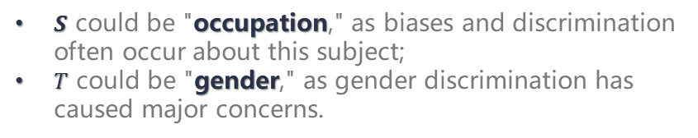
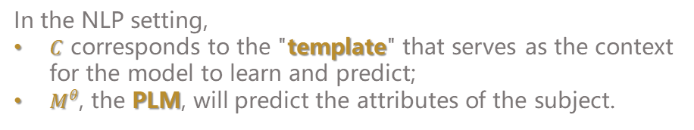


Problem Formulation
Subject $S$ and Discriminatory Topic $T$
Context $C$ and Learning Machine $M^{θ}$
$S$ could be "occupation," as biases and discrimination often occur about this subject;
$T$ could be "gender," as gender discrimination has caused major concerns.
In the NLP setting,
$C$ corresponds to the "template" that serves as the context for the model to learn and predict;
$M^{θ}$, the PLM, will predict the attributes of the subject.
6

Slide 7
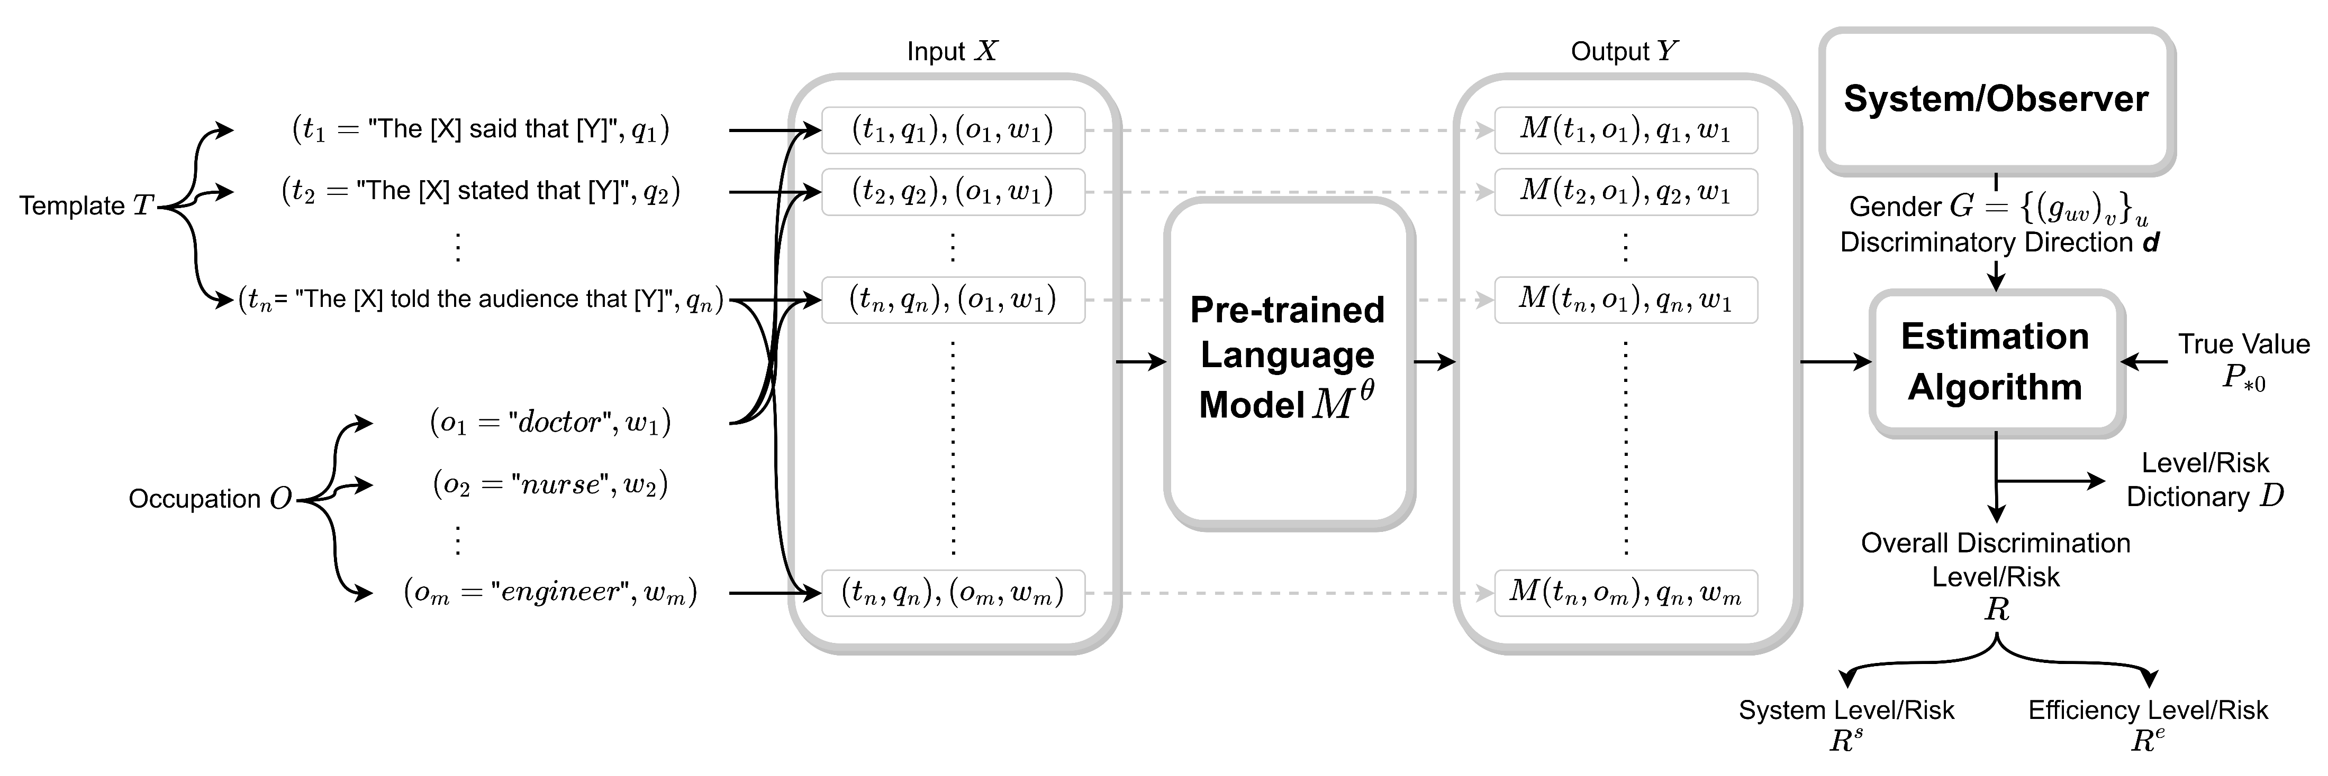

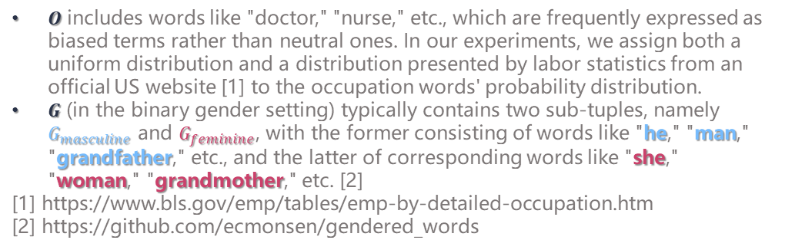

Problem Formulation
Occupation $O$ and Gender $G$
$O$ includes words like "doctor," "nurse," etc., which are frequently expressed as biased terms rather than neutral ones. In our experiments, we assign both a uniform distribution and a distribution presented by labor statistics from an official US website [1] to the occupation words' probability distribution.
$G$ (in the binary gender setting) typically contains two sub-tuples, namely $G_{masculine}$ and $G_{feminine}$, with the former consisting of words like "he," "man," "grandfather," etc., and the latter of corresponding words like "she," "woman," "grandmother," etc. [2]
[1] https://www.bls.gov/emp/tables/emp-by-detailed-occupation.htm
[2] https://github.com/ecmonsen/gendered_words
Pre-trained Language Model $M^{θ}$
T5, BART, RoBERTa, ALBERT, GPT-2, BERT, XLNet, distilBERT [3]
[3] We use the pre-trained models from the Hugging Face website: https://huggingface.co/. The papers for these models are listed on their model cards.
7

Slide 8
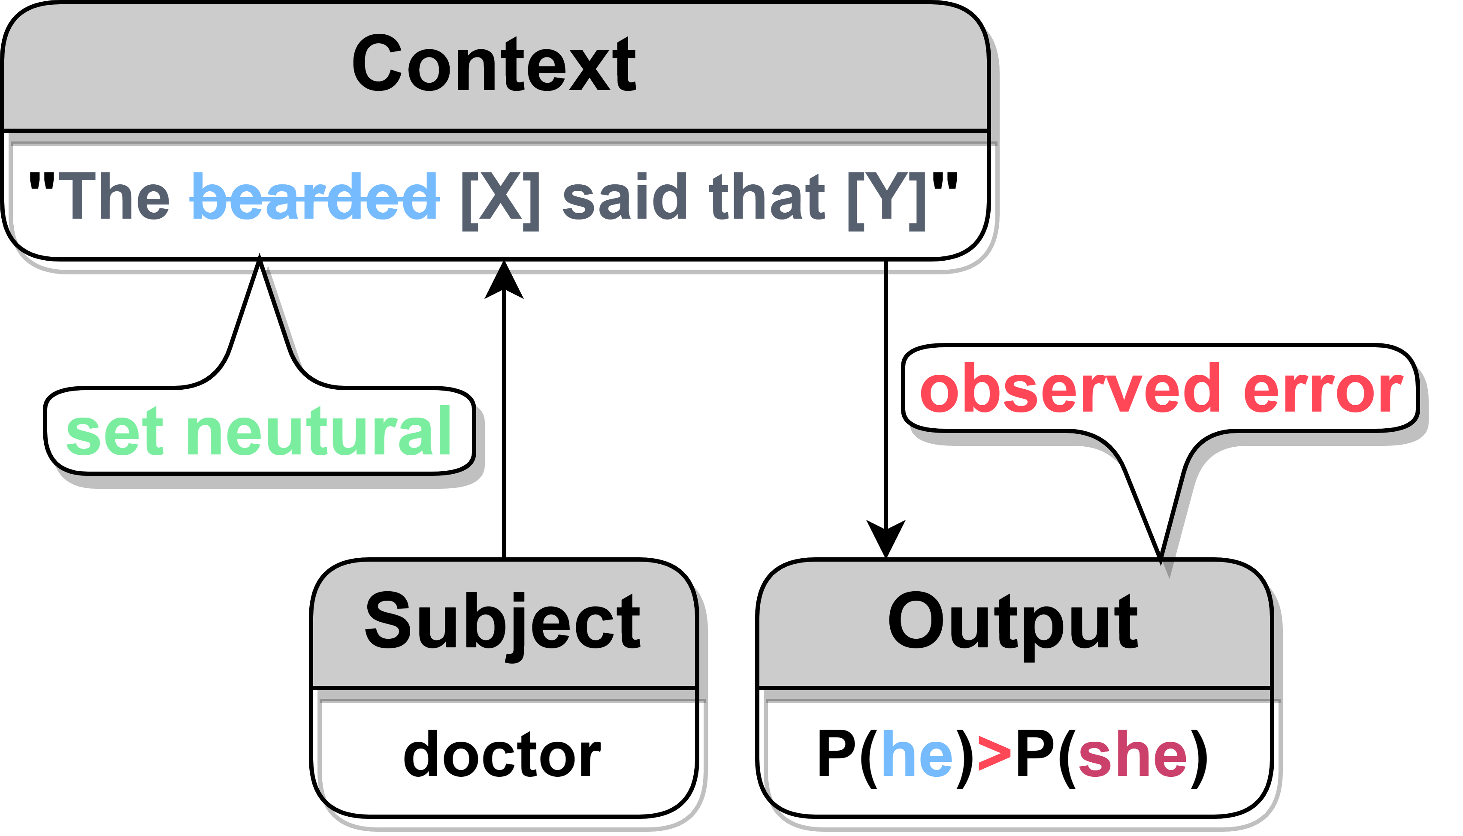

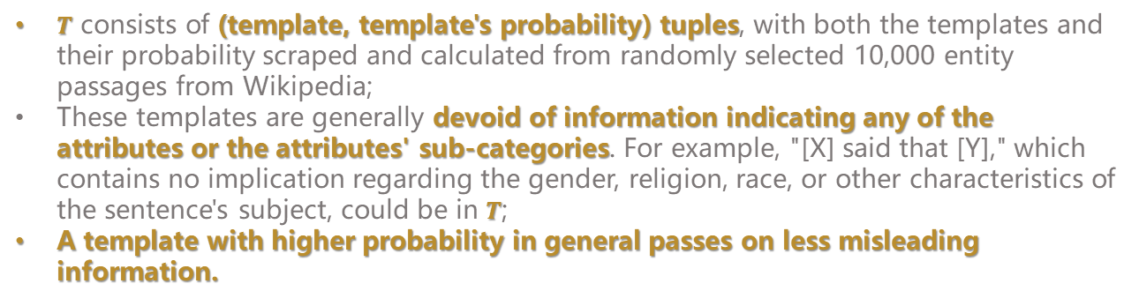
Problem Formulation
Template $T$
$T$ consists of (template, template's probability) tuples, with both the templates and their probability scraped and calculated from randomly selected 10,000 entity passages from Wikipedia;
These templates are generally devoid of information indicating any of the attributes or the attributes' sub-categories. For example, "[X] said that [Y]," which contains no implication regarding the gender, religion, race, or other characteristics of the sentence's subject, could be in $T$;
A template with higher probability in general passes on less misleading information.
8

Slide 9
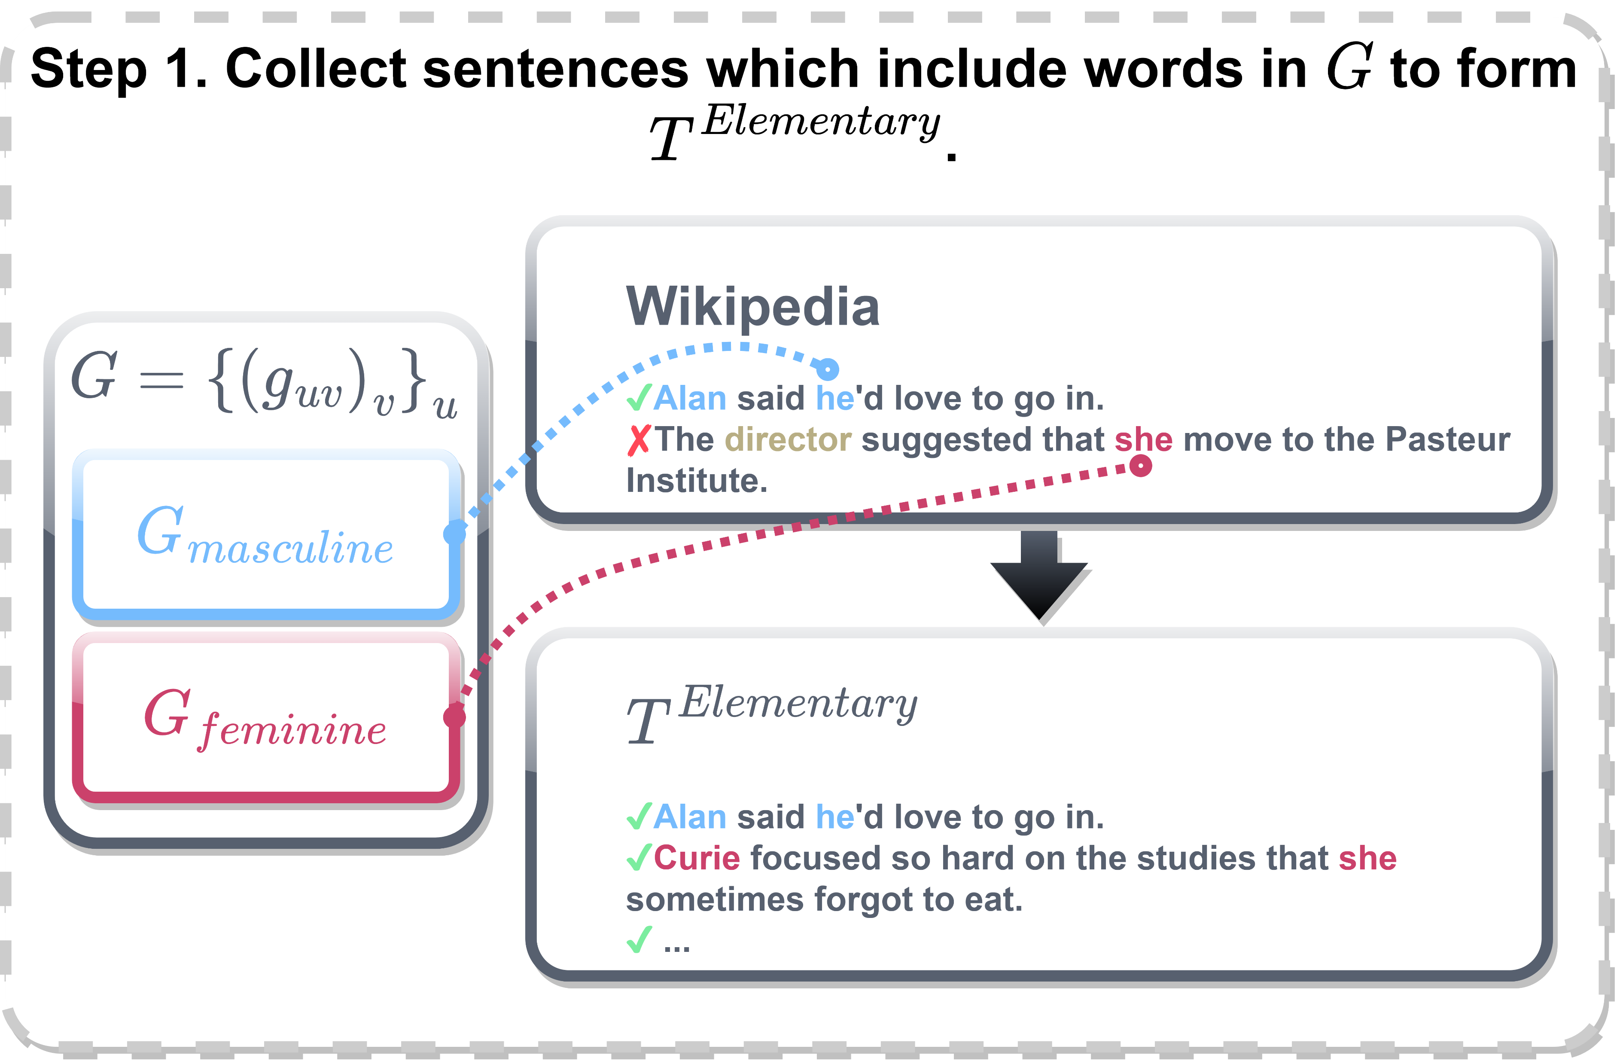
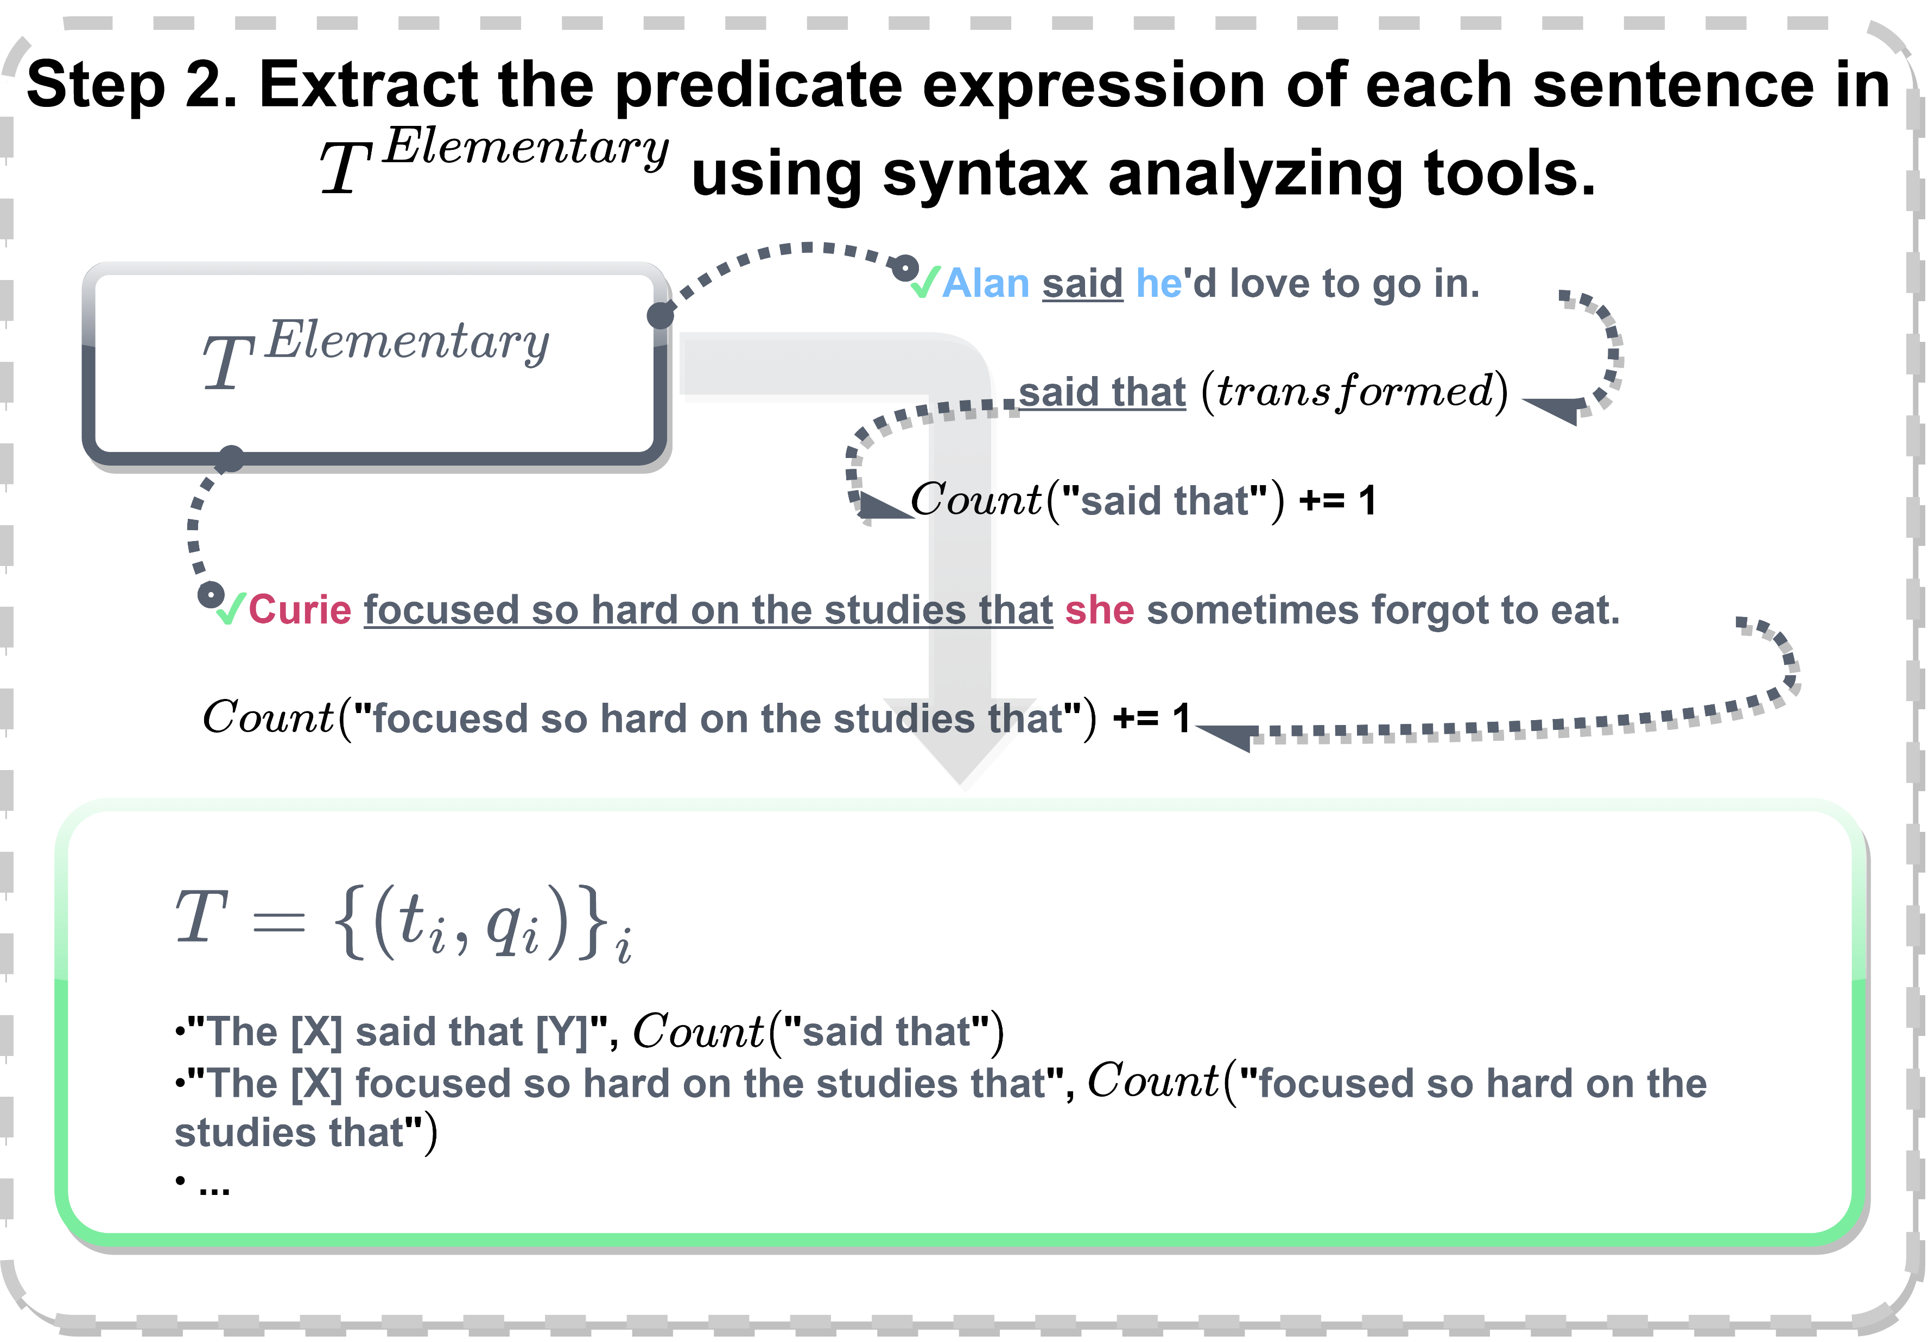
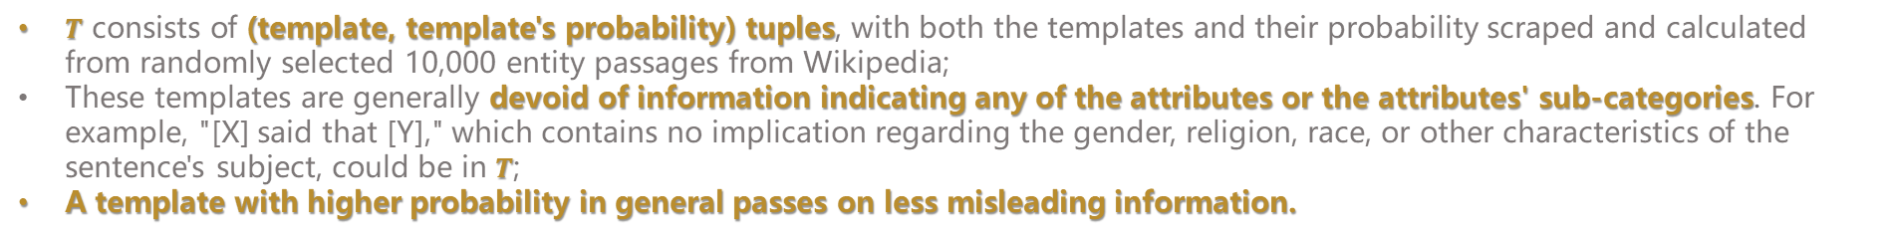
Template Sampling Method
Template $T$
$T$ consists of (template, template's probability) tuples, with both the templates and their probability scraped and calculated from randomly selected 10,000 entity passages from Wikipedia;
These templates are generally devoid of information indicating any of the attributes or the attributes' sub-categories. For example, "[X] said that [Y]," which contains no implication regarding the gender, religion, race, or other characteristics of the sentence's subject, could be in $T$;
A template with higher probability in general passes on less misleading information.
9

Slide 10
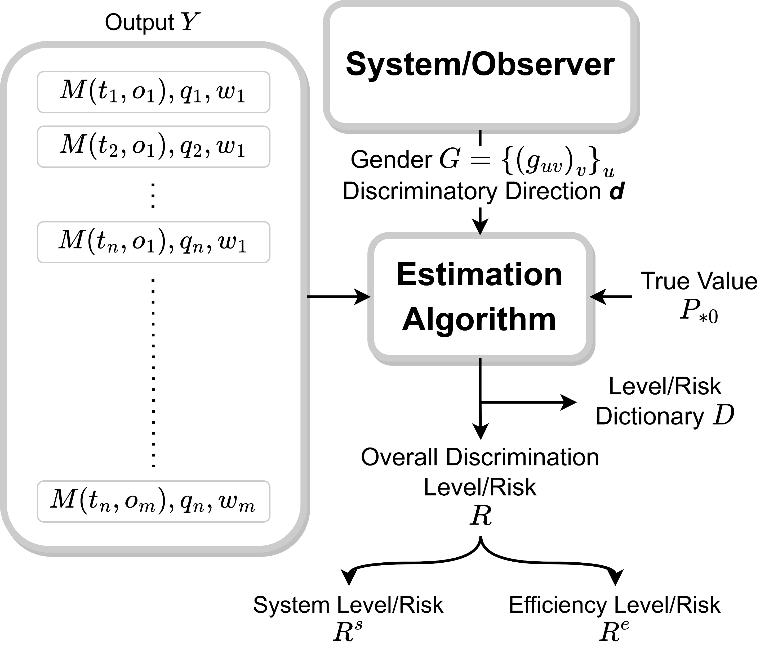
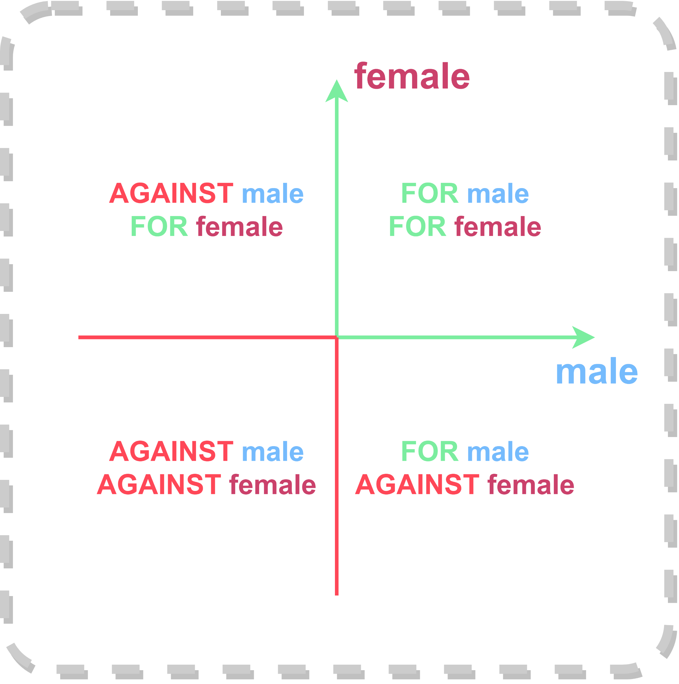
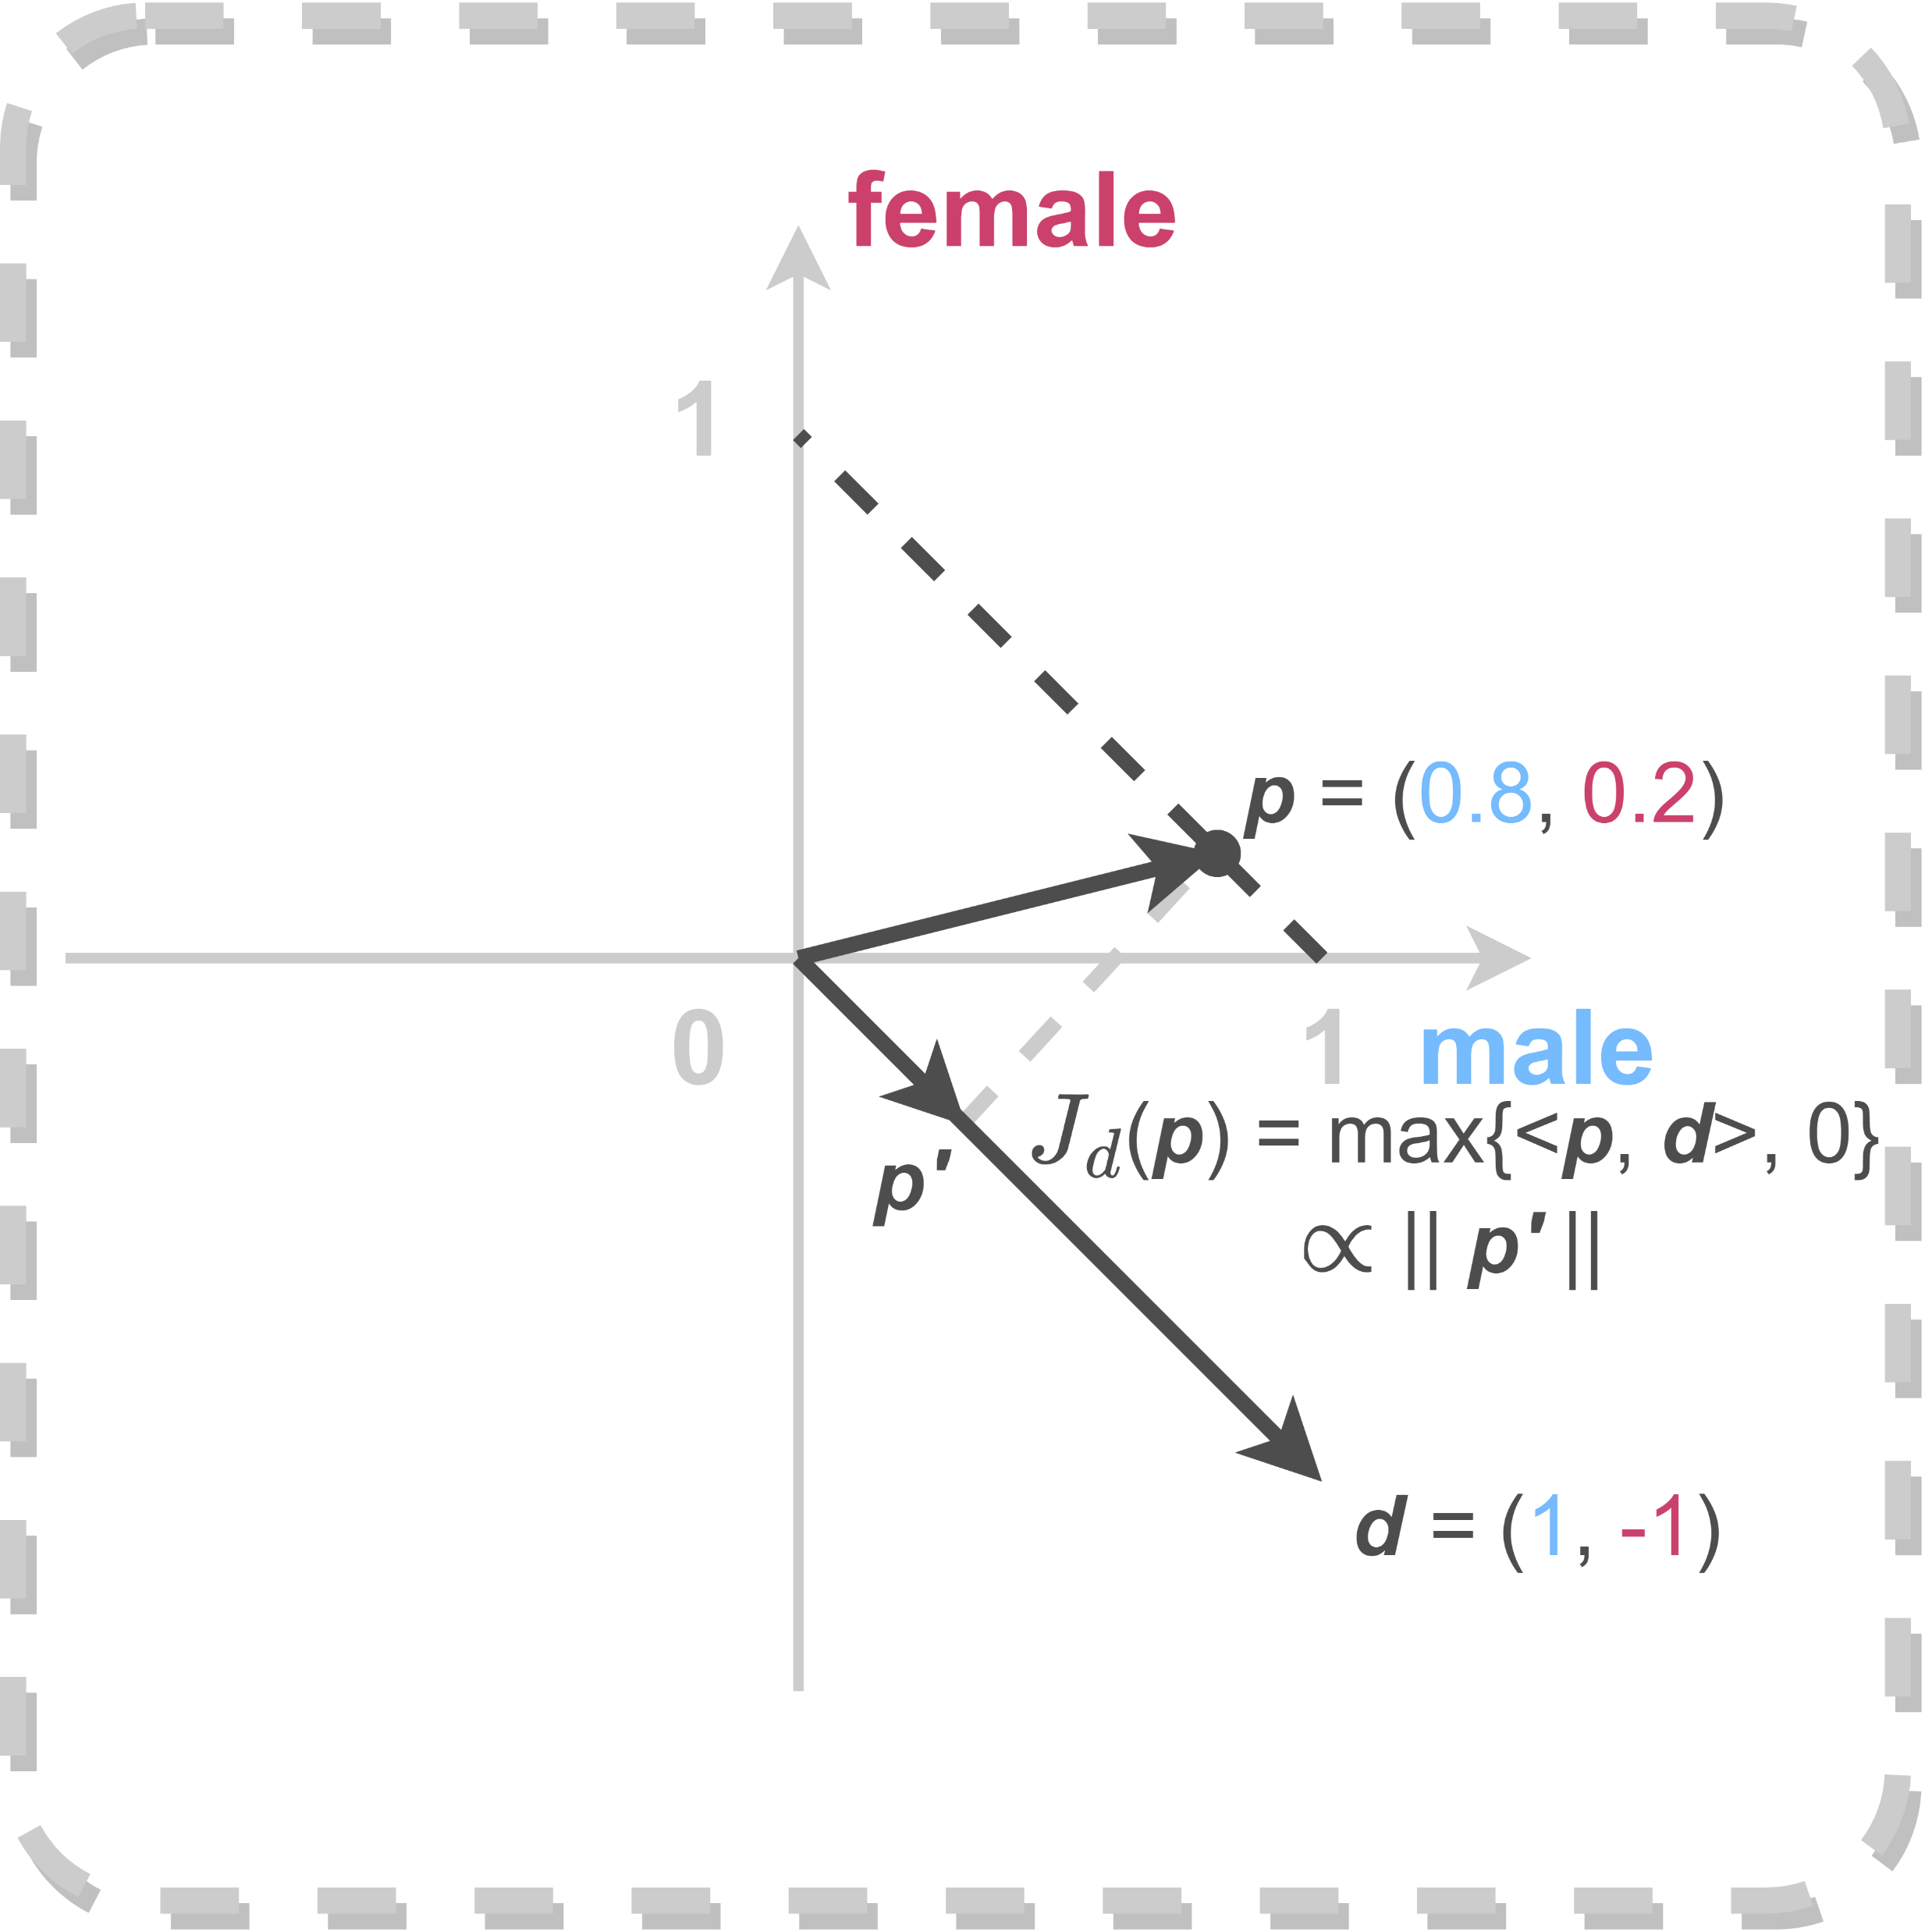
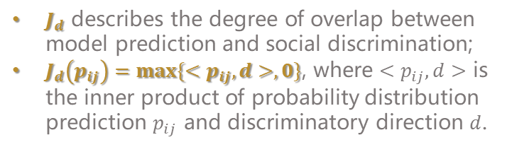


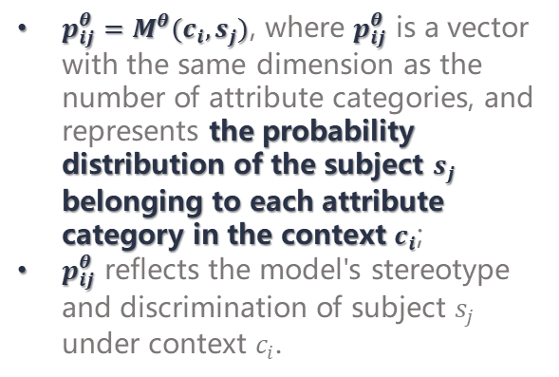
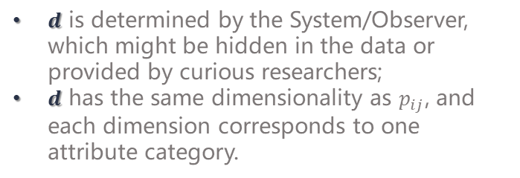

Preliminaries
Discriminatory Direction $d$
Discrimination Level Criterion $J_{d}$
$d$ is determined by the System/Observer, which might be hidden in the data or provided by curious researchers;
$d$ has the same dimensionality as $p_{ij}$, and each dimension corresponds to one attribute category.
$J_{d}$ describes the degree of overlap between model prediction and social discrimination;
$J_{d}\left(p_{ij}\right)=max⁡\{<p_{ij},d>,0\}$, where $<p_{ij},d>$ is the inner product of probability distribution prediction $p_{ij}$ and discriminatory direction $d$.
PLM's prediction $p_{ij}^{θ}$
$p_{ij}^{θ}=M^{θ}(c_{i},s_{j})$, where $p_{ij}^{θ}$ is a vector with the same dimension as the number of attribute categories, and represents the probability distribution of the subject $s_{j}$ belonging to each attribute category in the context $c_{i}$;
$p_{ij}^{θ}$ reflects the model's stereotype and discrimination of subject $s_{j}$ under context $c_{i}$.
10

Slide 11

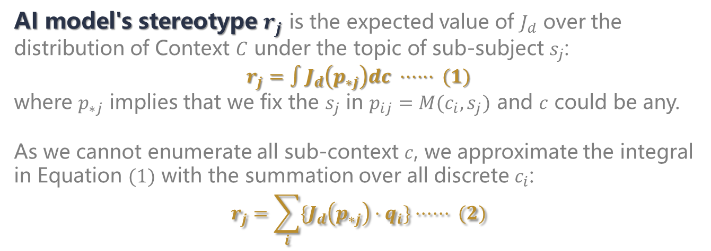
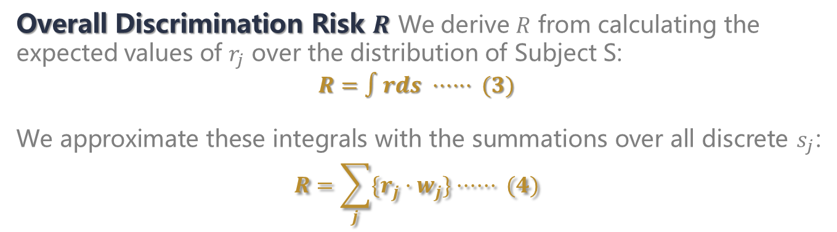
From AI's prediction to AI's discrimination
Definition 1
AI model's stereotype $r_{j}$ is the expected value of $J_{d}$ over the distribution of Context $C$ under the topic of sub-subject $s_{j}$:
$$r_{j}=∫J_{d}\left(p_{∗j}\right)dc ······ (1)$$
where $p_{∗j}$ implies that we fix the $s_{j}$ in $p_{ij}=M(c_{i},s_{j})$ and $c$ could be any.
As we cannot enumerate all sub-context $c$, we approximate the integral in Equation $(1)$ with the summation over all discrete $c_{i}$:
$$r_{j}=\sum_{i}{\{J_{d}\left(p_{∗j}\right)·q_{i}\}}······ (2)$$
We calculate the Overall Discrimination Risk $R$ according to the stereotype of the model on different sub-subjects $s_{j}$.
Definition 2
Overall Discrimination Risk $R$ We derive $R$ from calculating the expected values of $r_{j}$ over the distribution of Subject S:
$$R=∫rds ······ (3)$$
We approximate these integrals with the summations over all discrete $s_{j}$:
$$R=\sum_{j}{\{r_{j}·w_{j}\}}······ (4)$$
11

Slide 12
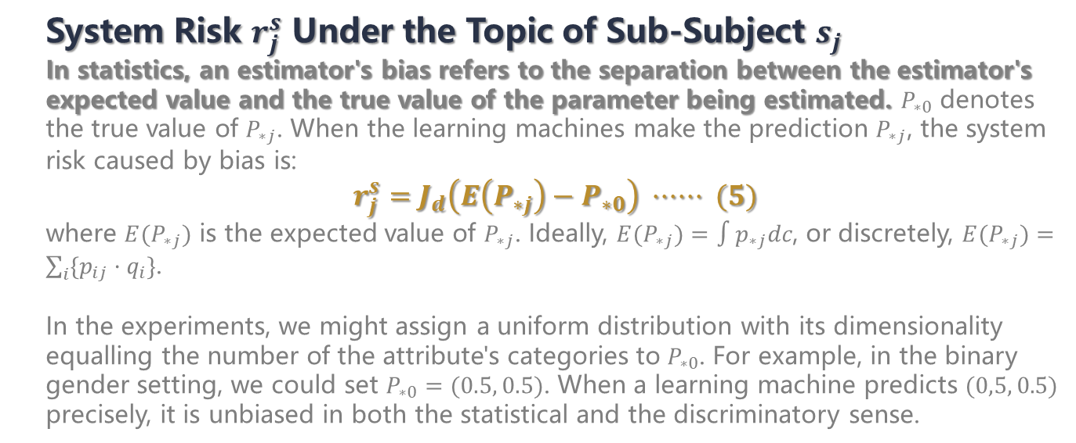
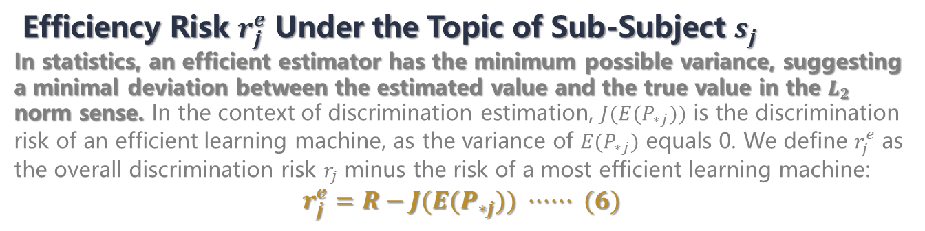
Discrimination Risk Ascription
Definition 3
System Risk $r_{j}^{s}$ Under the Topic of Sub-Subject $s_{j}$
In statistics, an estimator's bias refers to the separation between the estimator's expected value and the true value of the parameter being estimated. $P_{∗0}$ denotes the true value of $P_{∗j}$. When the learning machines make the prediction $P_{∗j}$, the system risk caused by bias is:
$$r_{j}^{s}=J_{d}\left(E\left(P_{∗j}\right)−P_{∗0}\right) ······ (5)$$
where $E(P_{∗j})$ is the expected value of $P_{∗j}$. Ideally, $E(P_{∗j})=∫p_{∗j}dc$, or discretely, $E(P_{∗j})=\sum_{i}{\{p_{ij}·q_{i}\}}$.
In the experiments, we might assign a uniform distribution with its dimensionality equalling the number of the attribute's categories to $P_{∗0}$. For example, in the binary gender setting, we could set $P_{∗0}=(0.5, 0.5)$. When a learning machine predicts $(0,5, 0.5)$ precisely, it is unbiased in both the statistical and the discriminatory sense.
Definition 4
Efficiency Risk $r_{j}^{e}$ Under the Topic of Sub-Subject $s_{j}$
In statistics, an efficient estimator has the minimum possible variance, suggesting a minimal deviation between the estimated value and the true value in the $L_{2}$ norm sense. In the context of discrimination estimation, $J(E(P_{∗j}))$ is the discrimination risk of an efficient learning machine, as the variance of $E(P_{∗j})$ equals 0. We define $r_{j}^{e}$ as the overall discrimination risk $r_{j}$ minus the risk of a most efficient learning machine:
$$r_{j}^{e}=R−J(E(P_{∗j})) ······ (6)$$
12

Slide 13
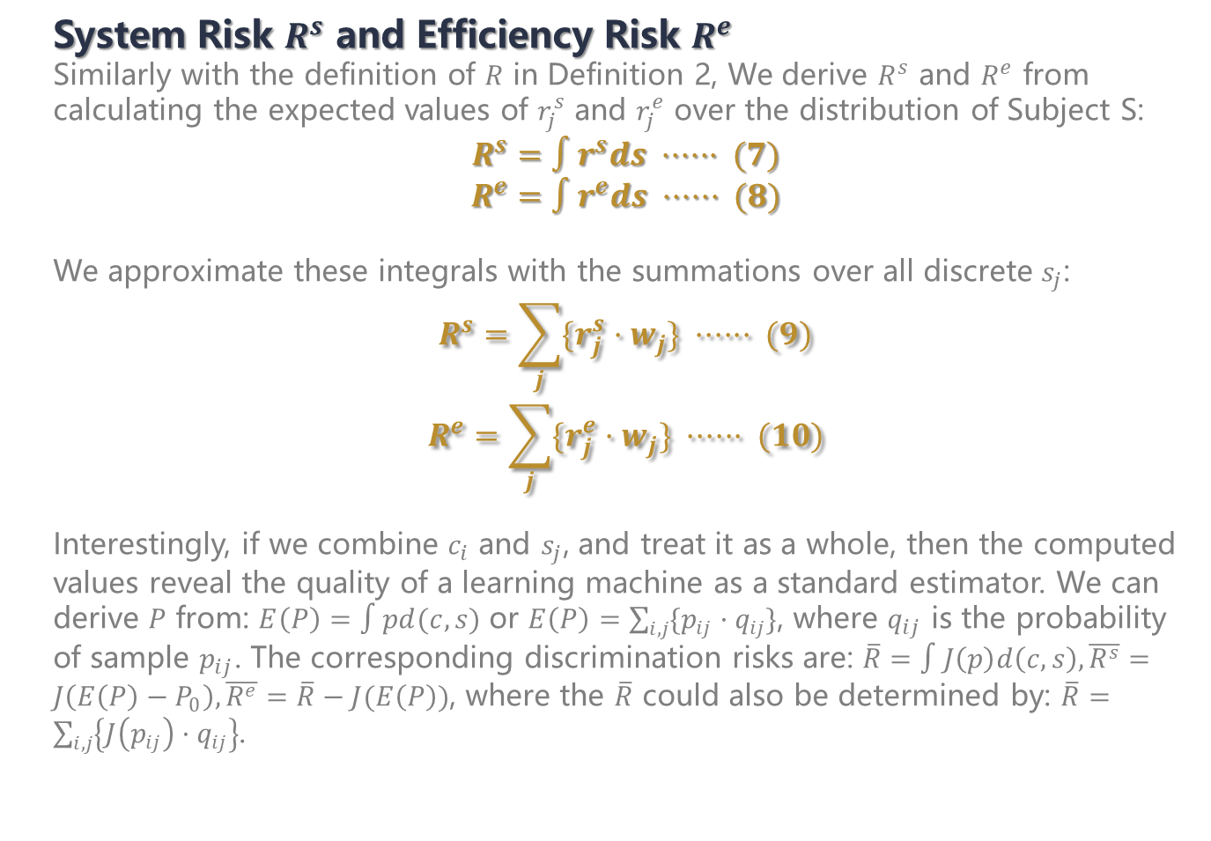
Discrimination Risk Ascription
Definition 5
System Risk $R^{s}$ and Efficiency Risk $R^{e}$
Similarly with the definition of $R$ in Definition 2, We derive $R^{s}$ and $R^{e}$ from calculating the expected values of $r_{j}^{s}$ and $r_{j}^{e}$ over the distribution of Subject S:
$$R^{s}=∫r^{s}ds ······ (7)$$
$$R^{e}=∫r^{e}ds ······ (8)$$
We approximate these integrals with the summations over all discrete $s_{j}$:
$$R^{s}=\sum_{j}{\{r_{j}^{s}·w_{j}\}} ······ (9)$$
$$R^{e}=\sum_{j}{\{r_{j}^{e}·w_{j}\}} ······ (10)$$
Interestingly, if we combine $c_{i}$ and $s_{j}$, and treat it as a whole, then the computed values reveal the quality of a learning machine as a standard estimator. We can derive $P$ from: $E\left(P\right)=∫pd(c,s)$ or $E\left(P\right)=\sum_{i,j}{\{p_{ij}·q_{ij}\}}$, where $q_{ij}$ is the probability of sample $p_{ij}$. The corresponding discrimination risks are: $\overline{R}=∫J\left(p\right)d\left(c,s\right), \overline{R^{s}}=J\left(E\left(P\right)−P_{0}\right), \overline{R^{e}}=\overline{R}−J(E\left(P\right))$, where the $\overline{R}$ could also be determined by: $\overline{R}=\sum_{i,j}{\left\{J\left(p_{ij}\right)·q_{ij}\right\}}$.
13

Slide 14
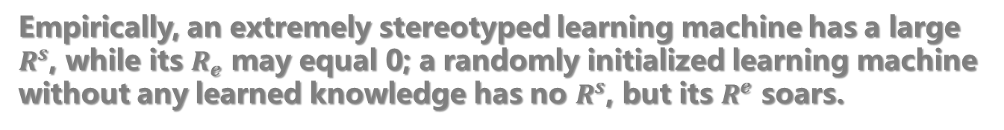
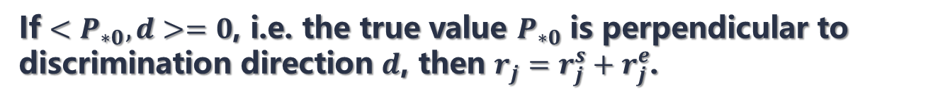

Discrimination Risk Ascription
It is noteworthy that under some conditions, there is a definite equation of relationships between $R$, $R^{s}$, and $R^{e}$:
Theorem 1
If $<P_{∗0}, d>=0$, i.e. the true value $P_{∗0}$ is perpendicular to discrimination direction $d$, then $r_{j}=r_{j}^{s}+r_{j}^{e}$.
Corollary 1
If $<P_{∗0}, d>=0$ holds for any $s_{j}$, then $R=R^{s}+R^{e}$.
Empirically, an extremely stereotyped learning machine has a large $R^{s}$, while its $R_{e}$ may equal 0; a randomly initialized learning machine without any learned knowledge has no $R^{s}$, but its $R^{e}$ soars.
14

Slide 15
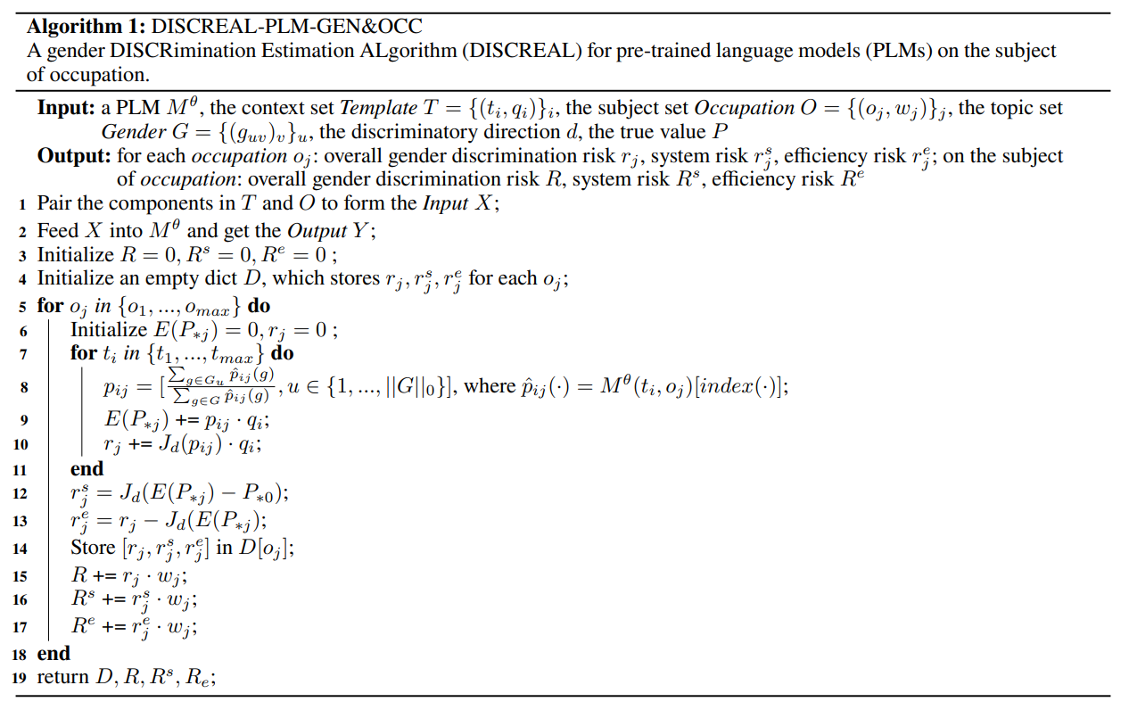




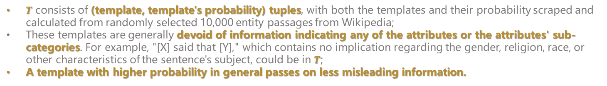
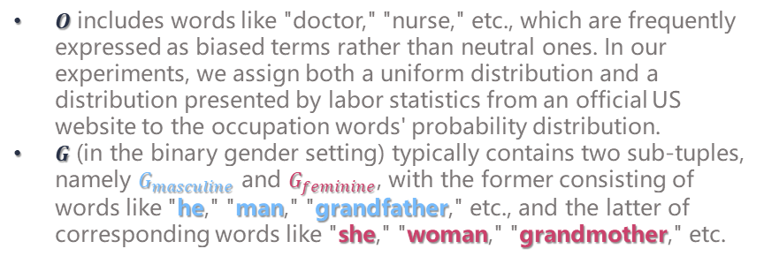


DISCRimination Estimation ALgorithm "DISCREAL"
Pre-trained Language Model $M^{θ}$
T5, BART, RoBERTa, ALBERT, GPT-2, BERT, XLNet, distilBERT
Occupation $O$ and Gender $G$
$O$ includes words like "doctor," "nurse," etc., which are frequently expressed as biased terms rather than neutral ones. In our experiments, we assign both a uniform distribution and a distribution presented by labor statistics from an official US website to the occupation words' probability distribution.
$G$ (in the binary gender setting) typically contains two sub-tuples, namely $G_{masculine}$ and $G_{feminine}$, with the former consisting of words like "he," "man," "grandfather," etc., and the latter of corresponding words like "she," "woman," "grandmother," etc.
Template $T$
$T$ consists of (template, template's probability) tuples, with both the templates and their probability scraped and calculated from randomly selected 10,000 entity passages from Wikipedia;
These templates are generally devoid of information indicating any of the attributes or the attributes' sub-categories. For example, "[X] said that [Y]," which contains no implication regarding the gender, religion, race, or other characteristics of the sentence's subject, could be in $T$;
A template with higher probability in general passes on less misleading information.
15

Slide 16
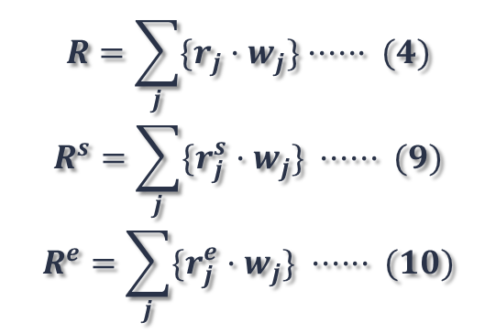
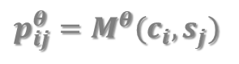
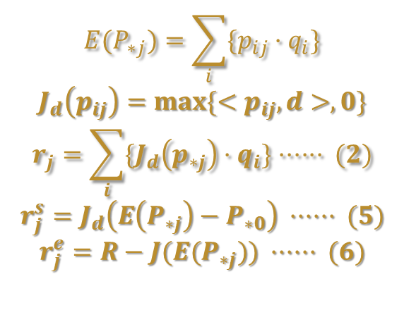
DISCRimination Estimation ALgorithm "DISCREAL"
$$p_{ij}^{θ}=M^{θ}(c_{i},s_{j})$$
$$E(P_{∗j})=\sum_{i}{\{p_{ij}·q_{i}\}}$$
$$J_{d}\left(p_{ij}\right)=max⁡\{<p_{ij},d>,0\}$$
$$r_{j}=\sum_{i}{\{J_{d}\left(p_{∗j}\right)·q_{i}\}}······ (2)$$
$$r_{j}^{s}=J_{d}\left(E\left(P_{∗j}\right)−P_{∗0}\right) ······ (5)$$
$$r_{j}^{e}=R−J(E(P_{∗j})) ······ (6)$$
$$R=\sum_{j}{\{r_{j}·w_{j}\}}······ (4)$$
$$R^{s}=\sum_{j}{\{r_{j}^{s}·w_{j}\}} ······ (9)$$
$$R^{e}=\sum_{j}{\{r_{j}^{e}·w_{j}\}} ······ (10)$$
16

Slide 17

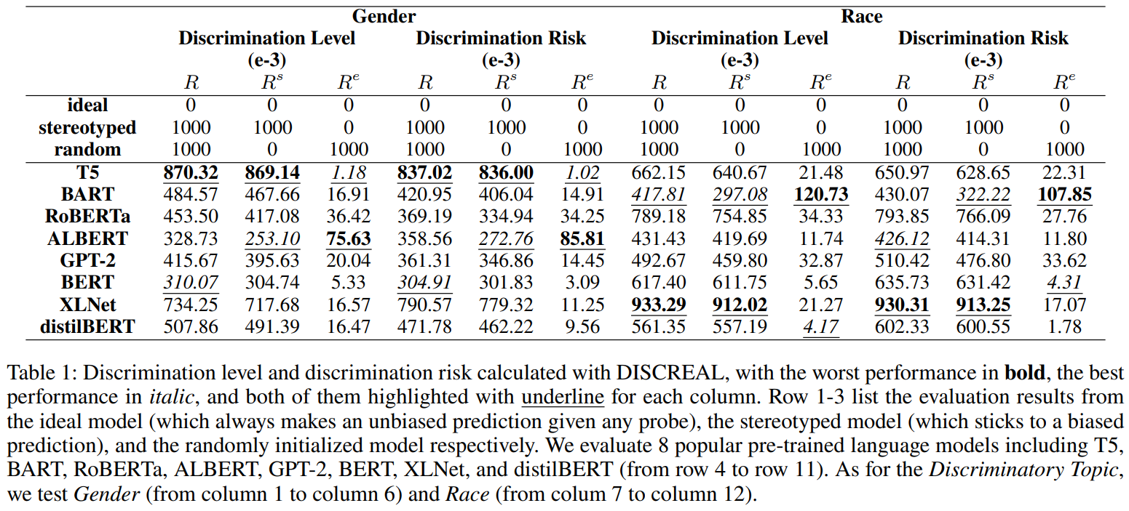

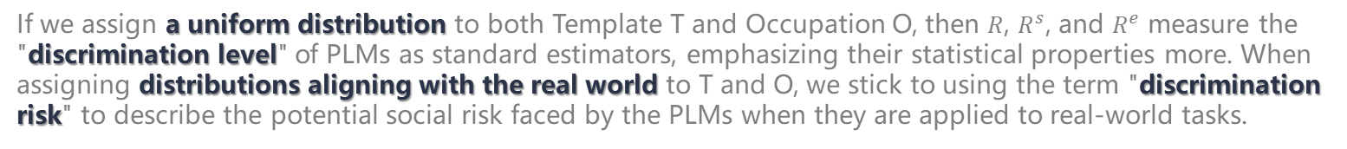
Results
If we assign a uniform distribution to both Template T and Occupation O, then $R$, $R^{s}$, and $R^{e}$ measure the "discrimination level" of PLMs as standard estimators, emphasizing their statistical properties more. When assigning distributions aligning with the real world to T and O, we stick to using the term "discrimination risk" to describe the potential social risk faced by the PLMs when they are applied to real-world tasks.
We could compare the discrimination level/risk of various PLMs under different topics with DISCREAL.
17

Slide 18
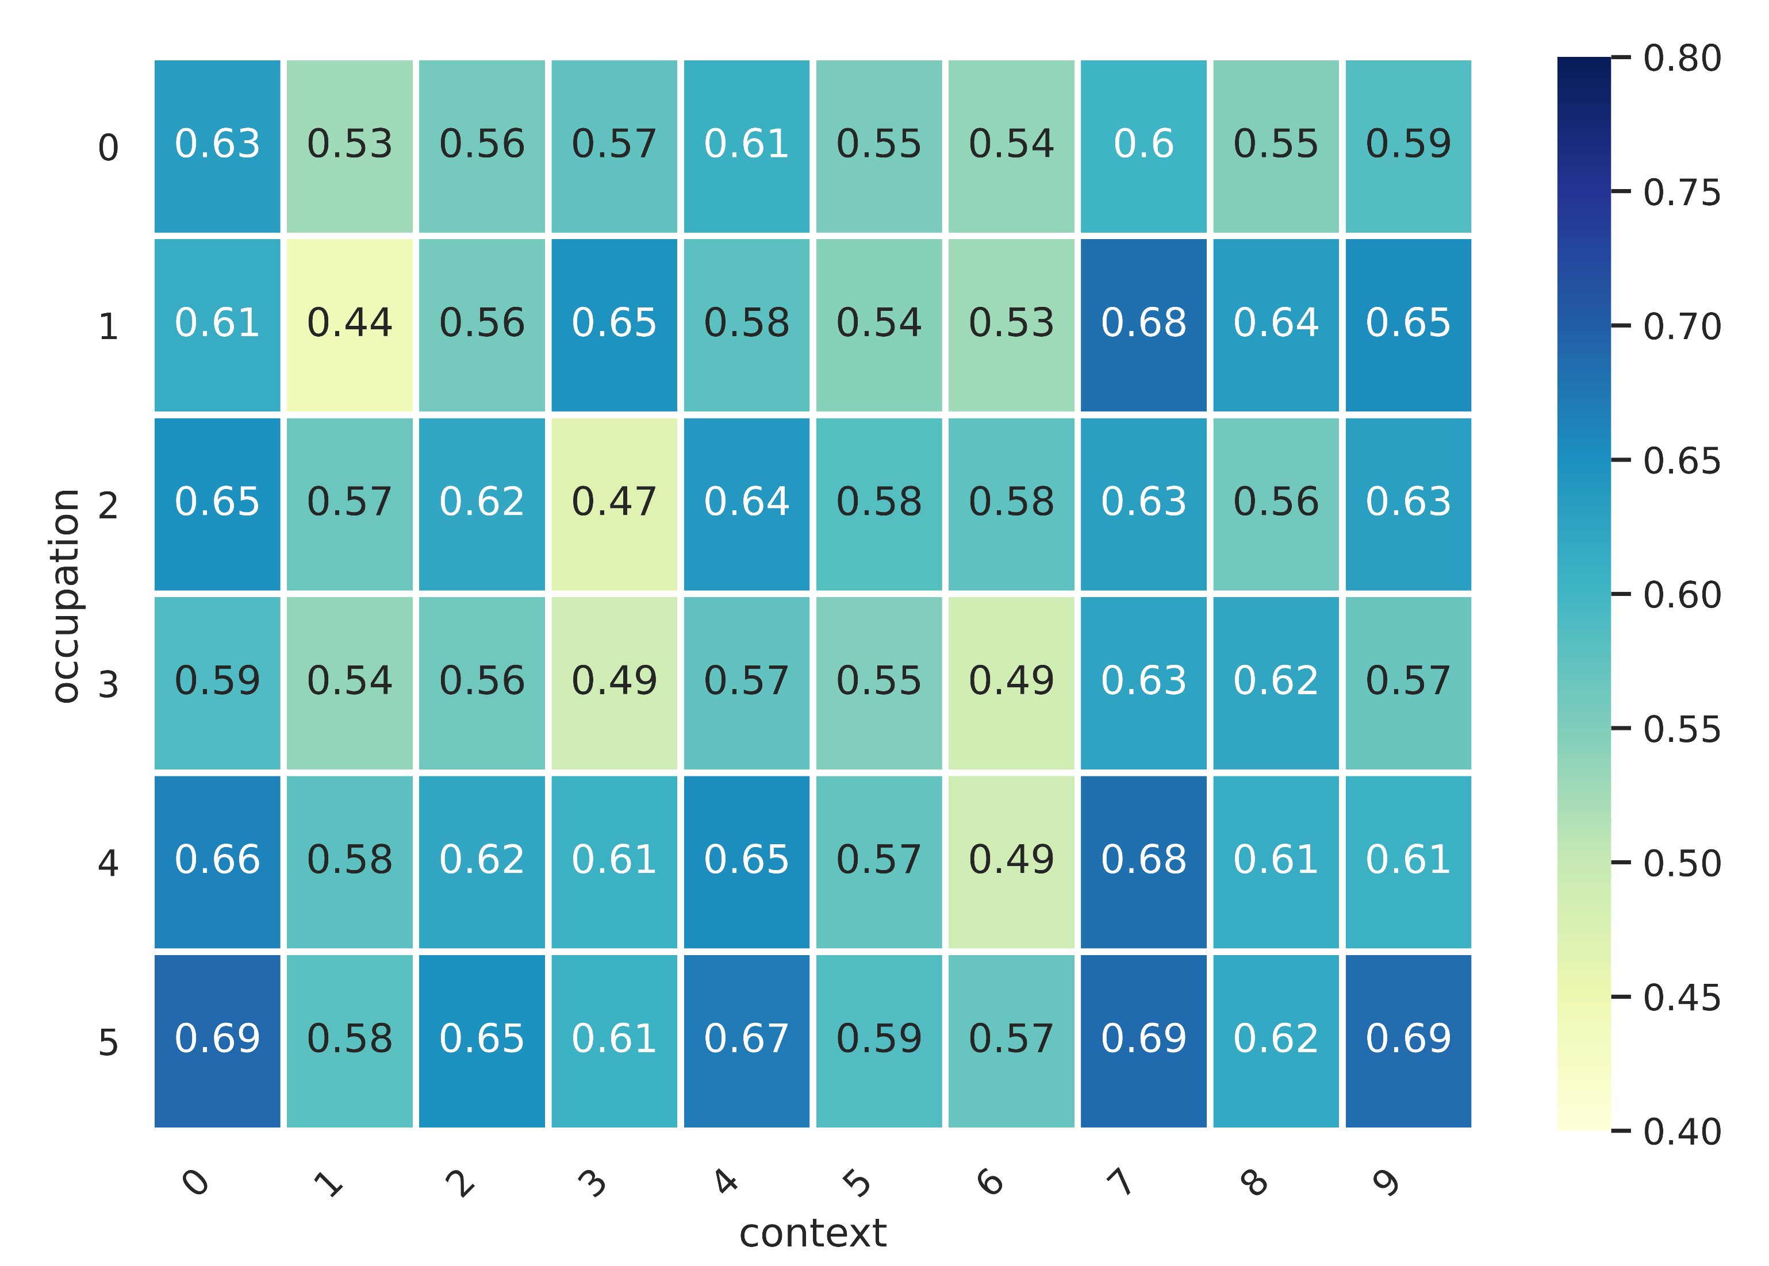

Results
AI would exhibit biased or inconsistent outputs, depending largely on the contexts.
AI models and humans may have different stereotypes about the same profession.
Social discrimination may lead to the belief that nurses are predominantly female, while AI models such as T5, BERT, RoBERTA, and XLNet may classify nurses as more likely to be male.
BERT's gender prediction for the (0) nurse, (1) stylist, (2) receptionist, (3) doctor, (4) programmer, and (5) captain in different texts. The 10 templates are: (0) "The [X] explained that [Y]," (1) "The [X] confirmed that [Y]," (2) "The [X] told that [Y]," (3) "The [X] found that [Y]," (4) "The [X] mentioned that [Y]," (5) "The [X] was old [Y]," (6) "The [X] was one [Y]," (7) "The [X] asked if [Y]," (8) "The [X] was aware that [Y]," (9) "The [X] alleged that [Y]." The values in the figure represent the probability that the model believes that the occupation in the corresponding sentence is male.
18

Slide 19
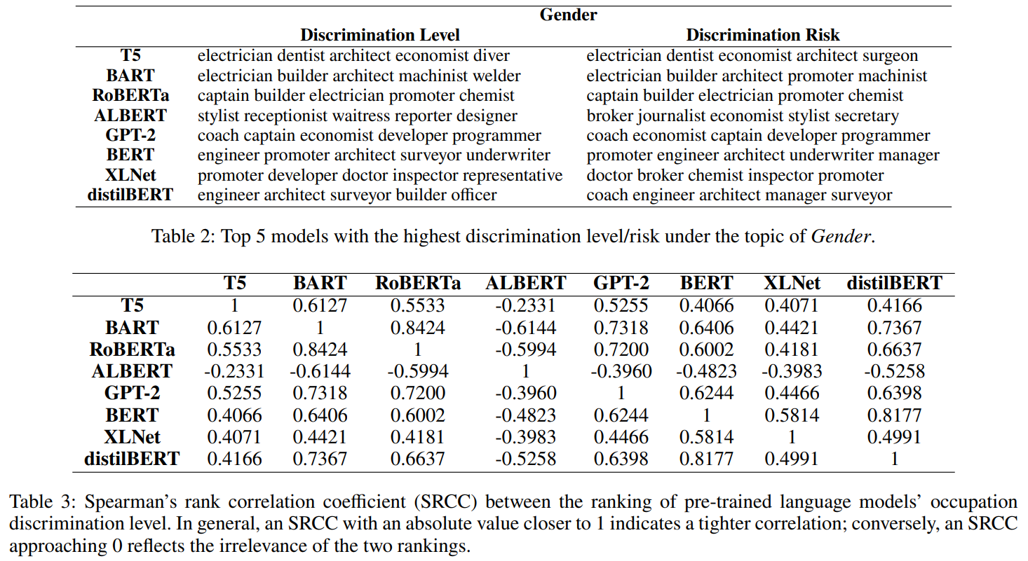
Results
AI models differ significantly in their inherent discrimination level, and there is no distinct discrimination pattern as could be observed in human society.
19

Slide 20
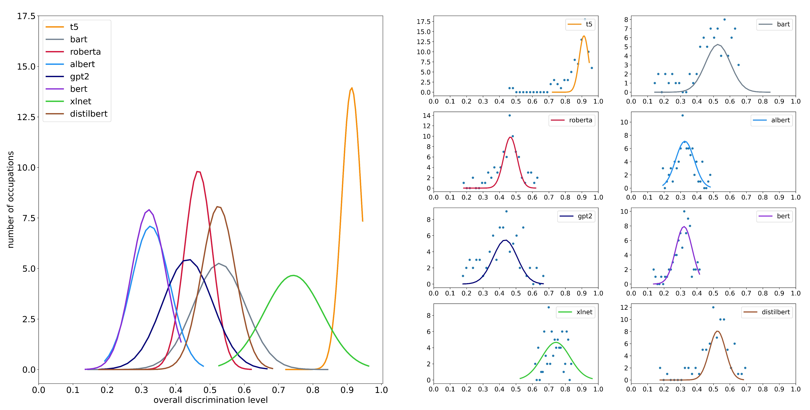
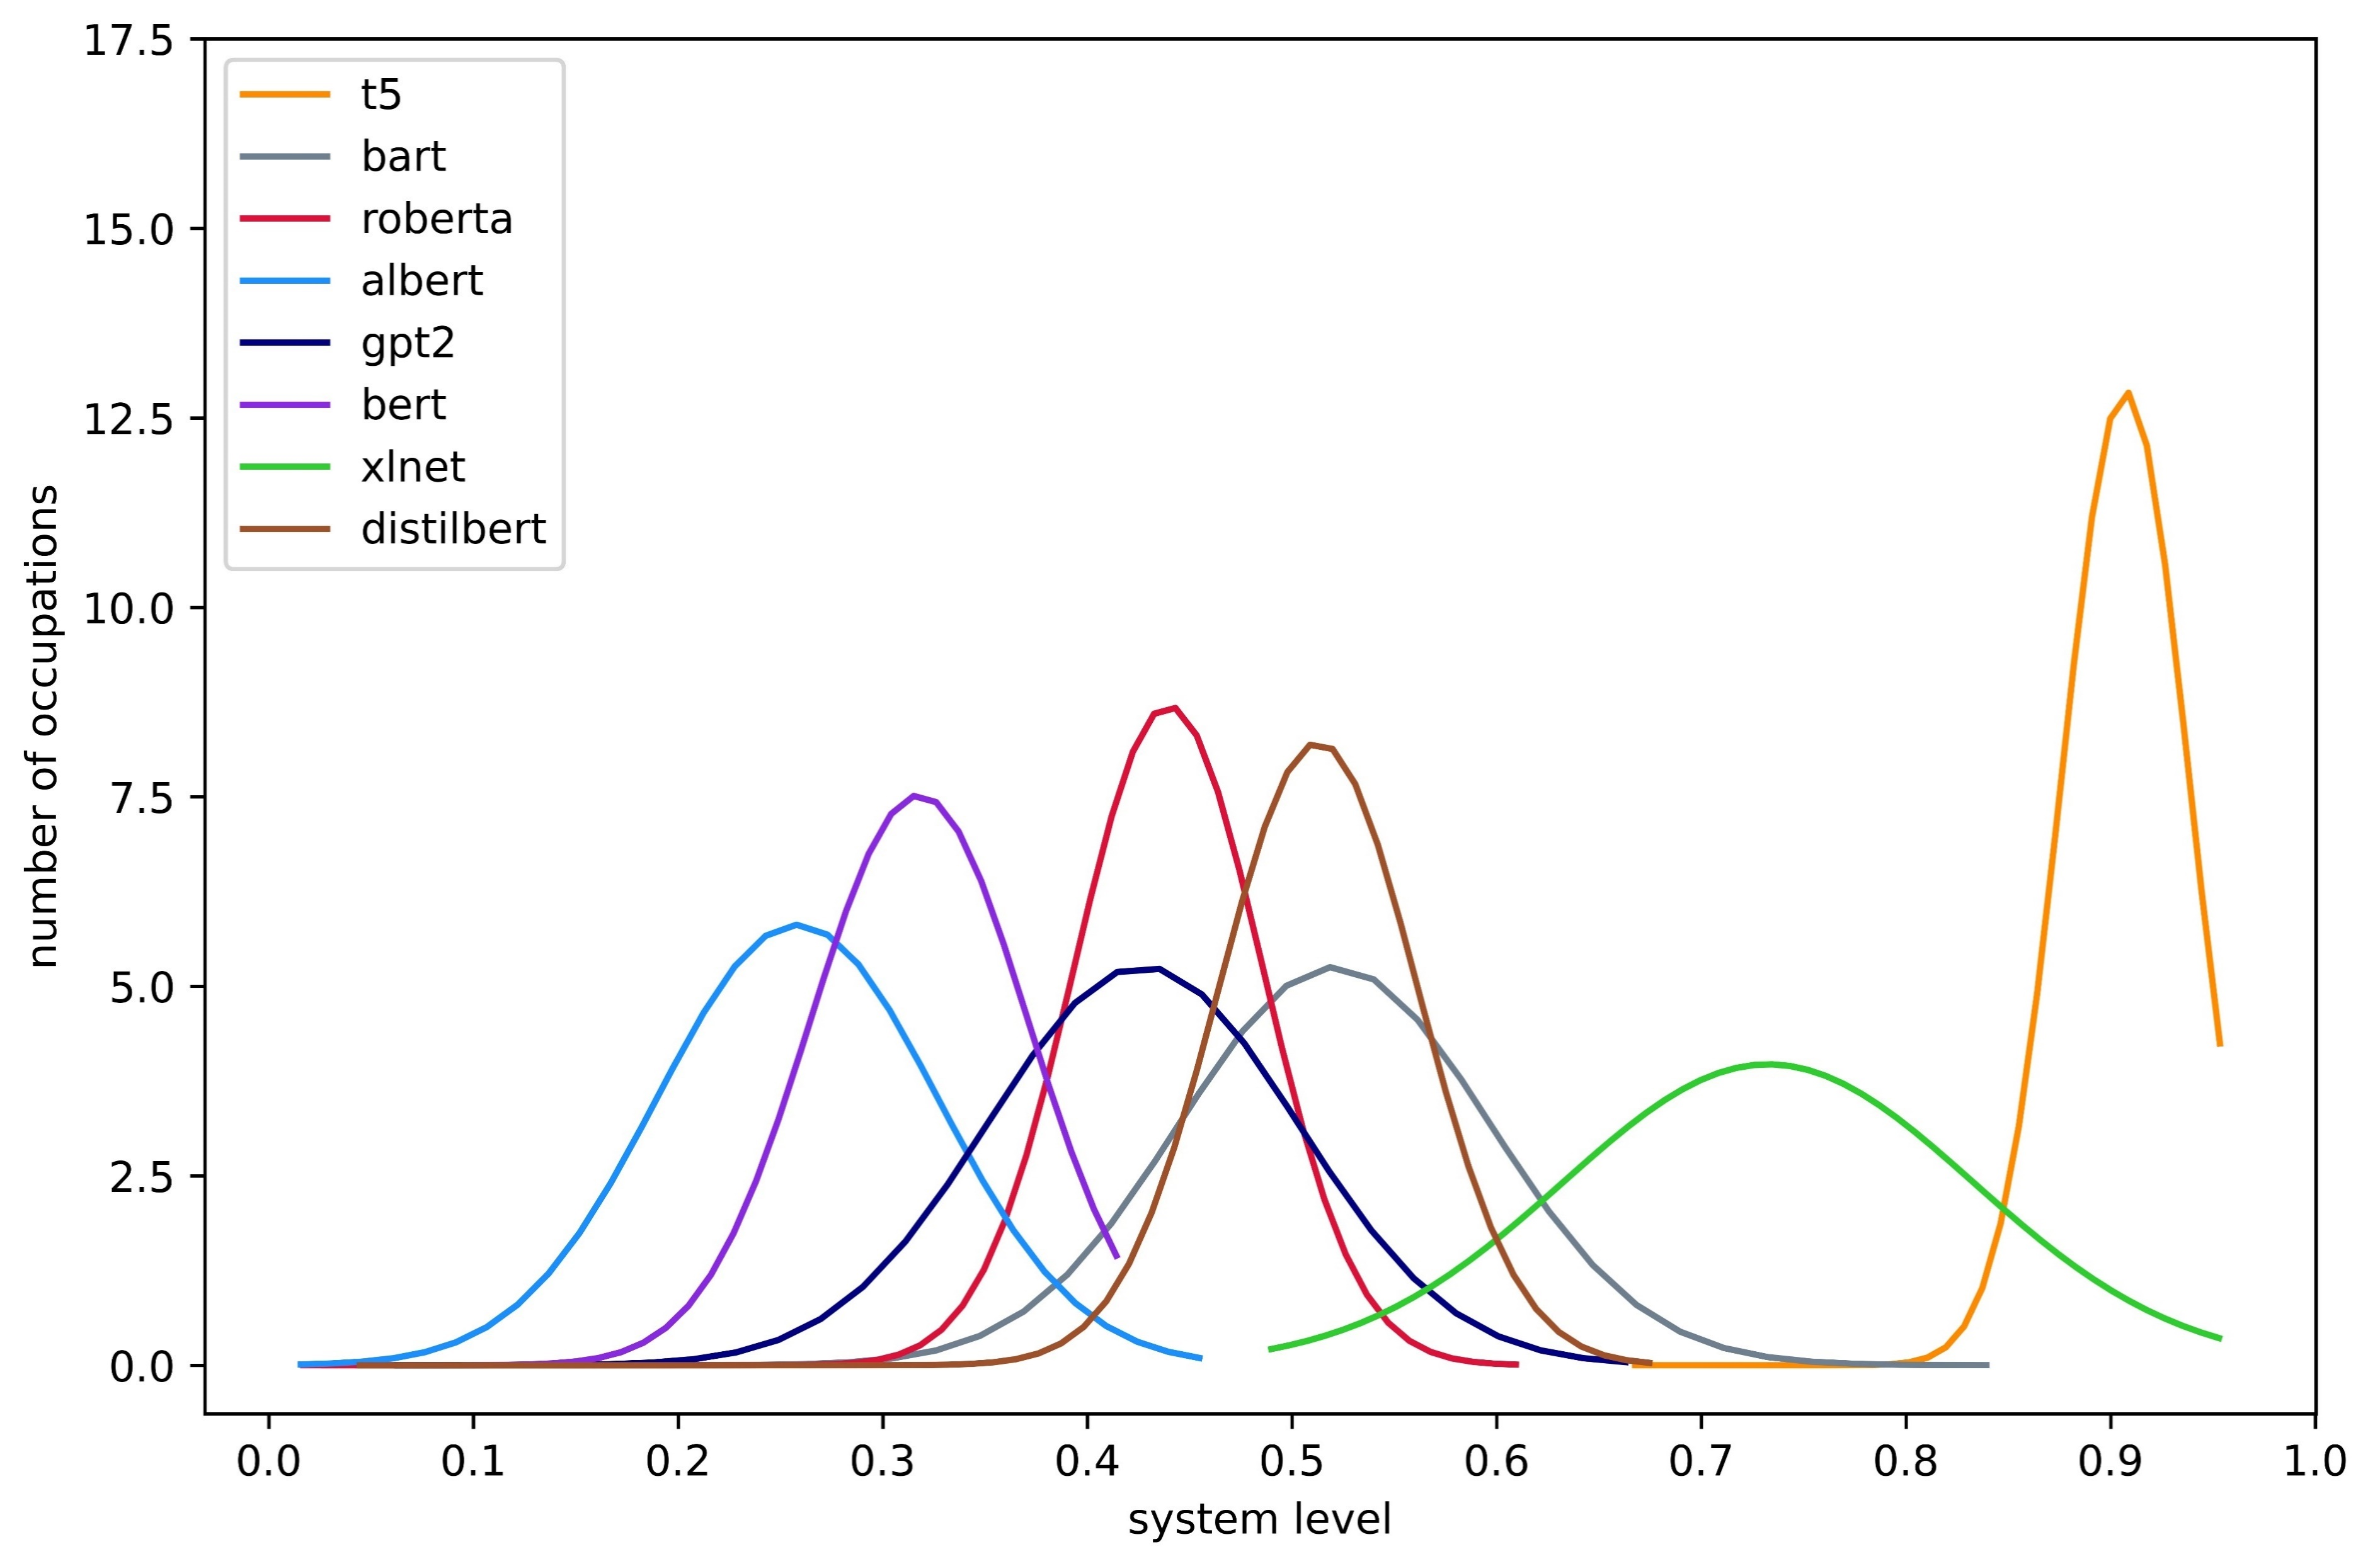
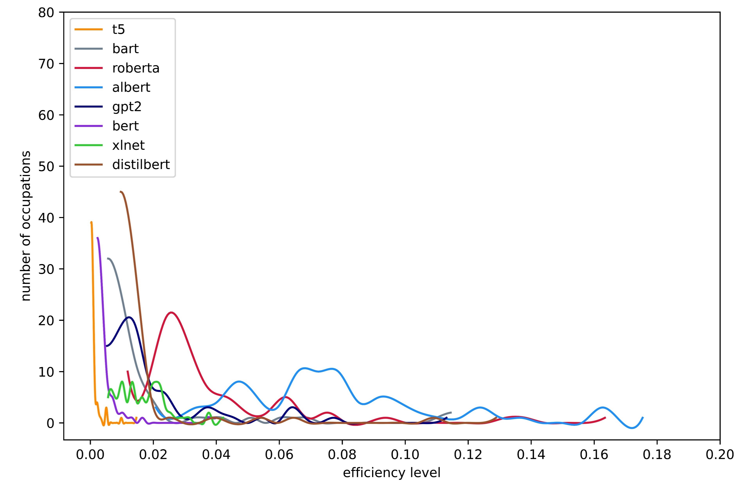
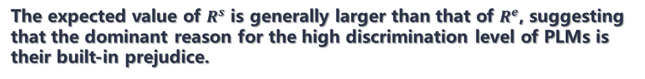
Results
The overall discrimination level under the topic of Gender. We first fit the overall discrimination distribution with normal distribution (right), and then map the distribution shape of each pre-trained language models to the same coordinate system (left).
The expected value of $R^{s}$ is generally larger than that of $R^{e}$, suggesting that the dominant reason for the high discrimination level of PLMs is their built-in prejudice.
The detailed discrimination decomposition under the topic of Gender. We fit the system level distribution with normal distribution. To better demonstrate the amorphous distribution of efficiency level, we perform interpolation on the calculated values and plot the interpolated lines.
The distribution of $R^{s}$ is typically bell-shaped, while the distribution of $R^{e}$ often follows a long-tail pattern.
20

Slide 21
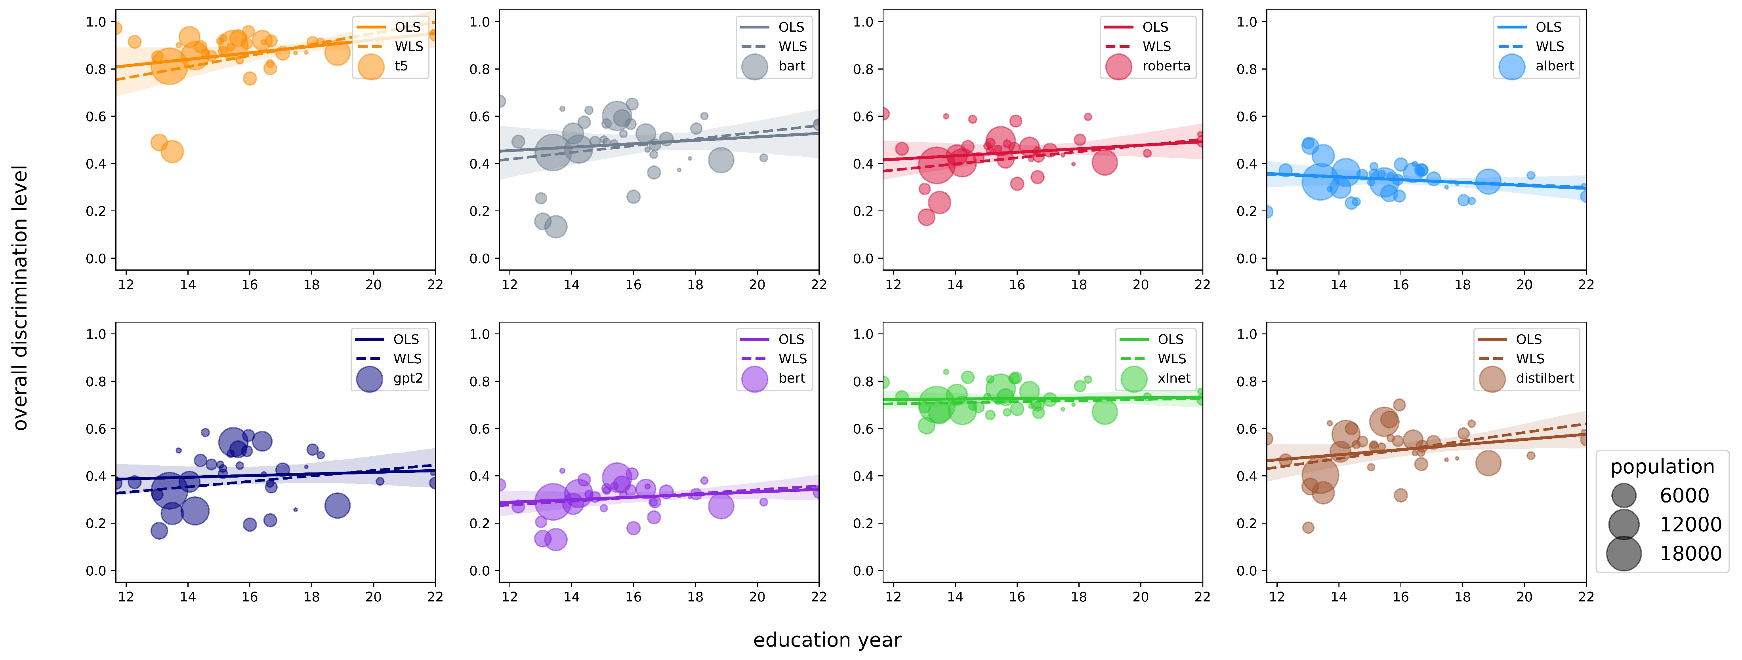
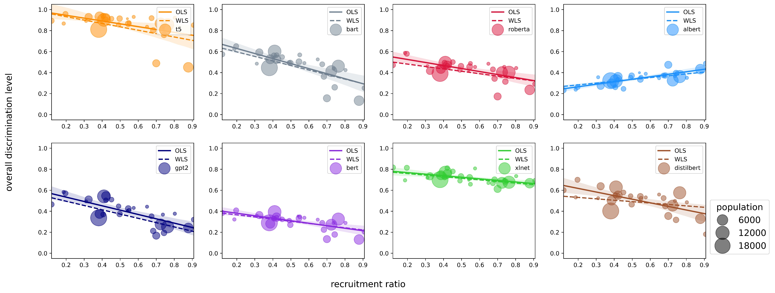
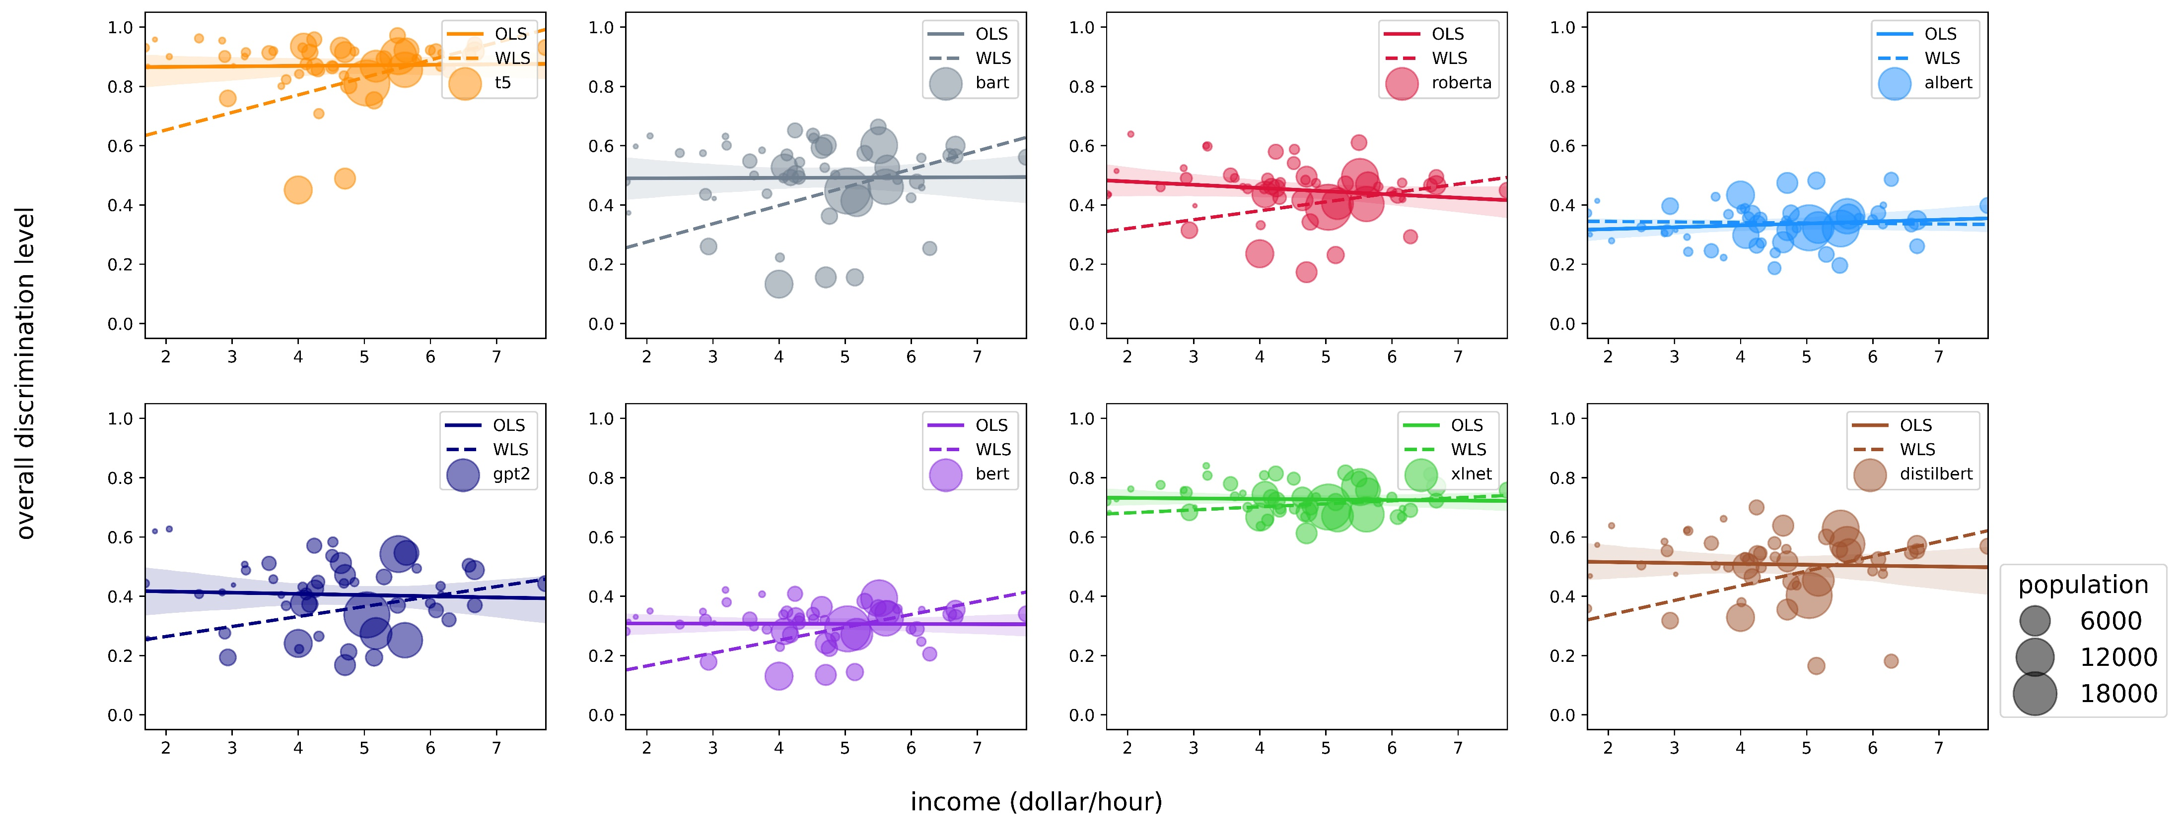
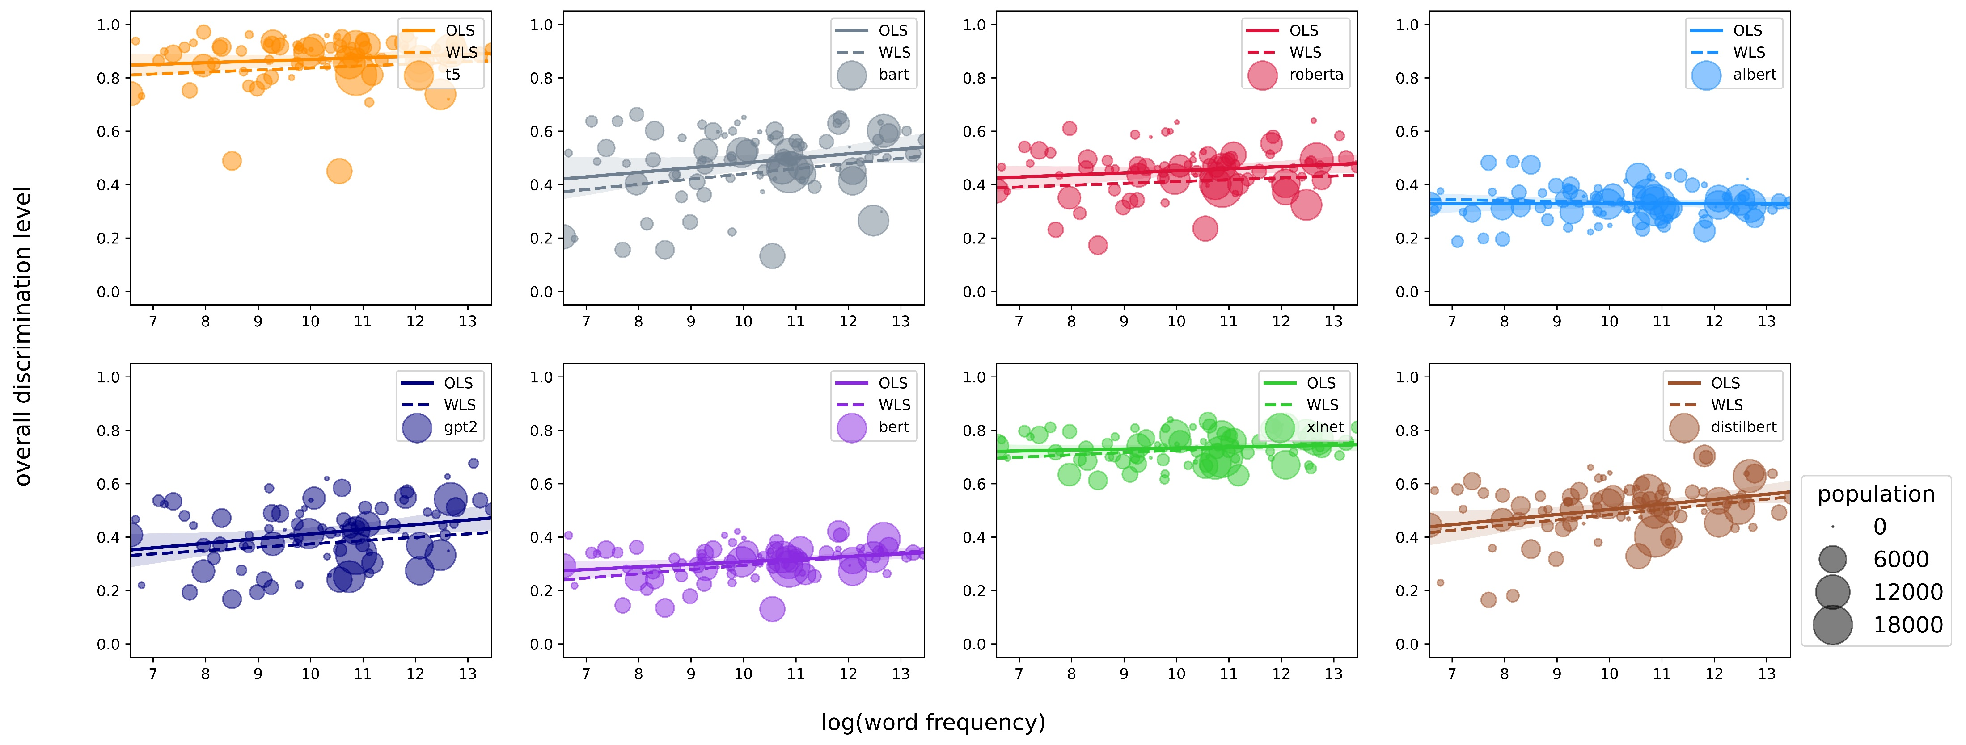
The Correlation Between Social and Economic Factors and the PLMs' Discrimination Level
The regressions between social and economic factors (i.e., education year [1], recruitment ratio [2], salary [3], and word frequency [4]) and Gender discrimination level. In every sub-plot, each point denotes an occupation, with its size indicating the population of that occupation. We present the result determined by the ordinary least squares (OLS) principle with solid lines, and by the weighted least squares (WLS) principle, where the weights are derived from the labor statistics by occupation, with dashed lines.
PLMs are more likely to make prejudiced predictions for occupations with a higher proportion of women.
[1] https://www.bls.gov/emp/tables/educational-attainment.htm [2] https://www.bls.gov/cps/cpsaat11.htm [3] https://www.bls.gov/mwe/tables.htm
[4] https://github.com/IlyaSemenov/wikipedia-word-frequency/blob/master/results/enwiki-2022-08-29.txt
21

Slide 22
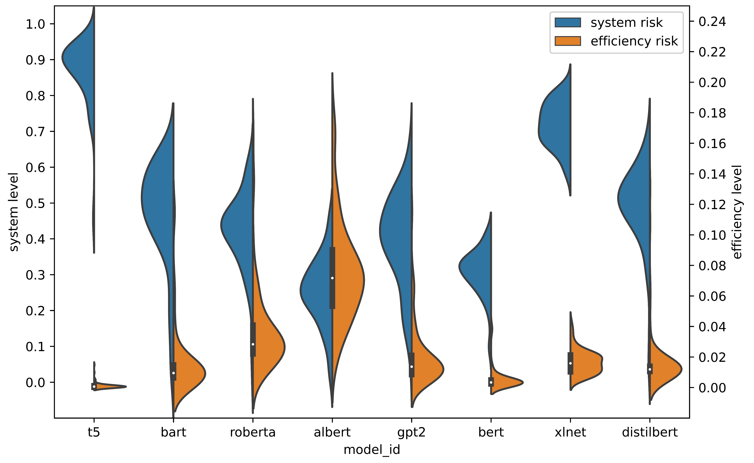
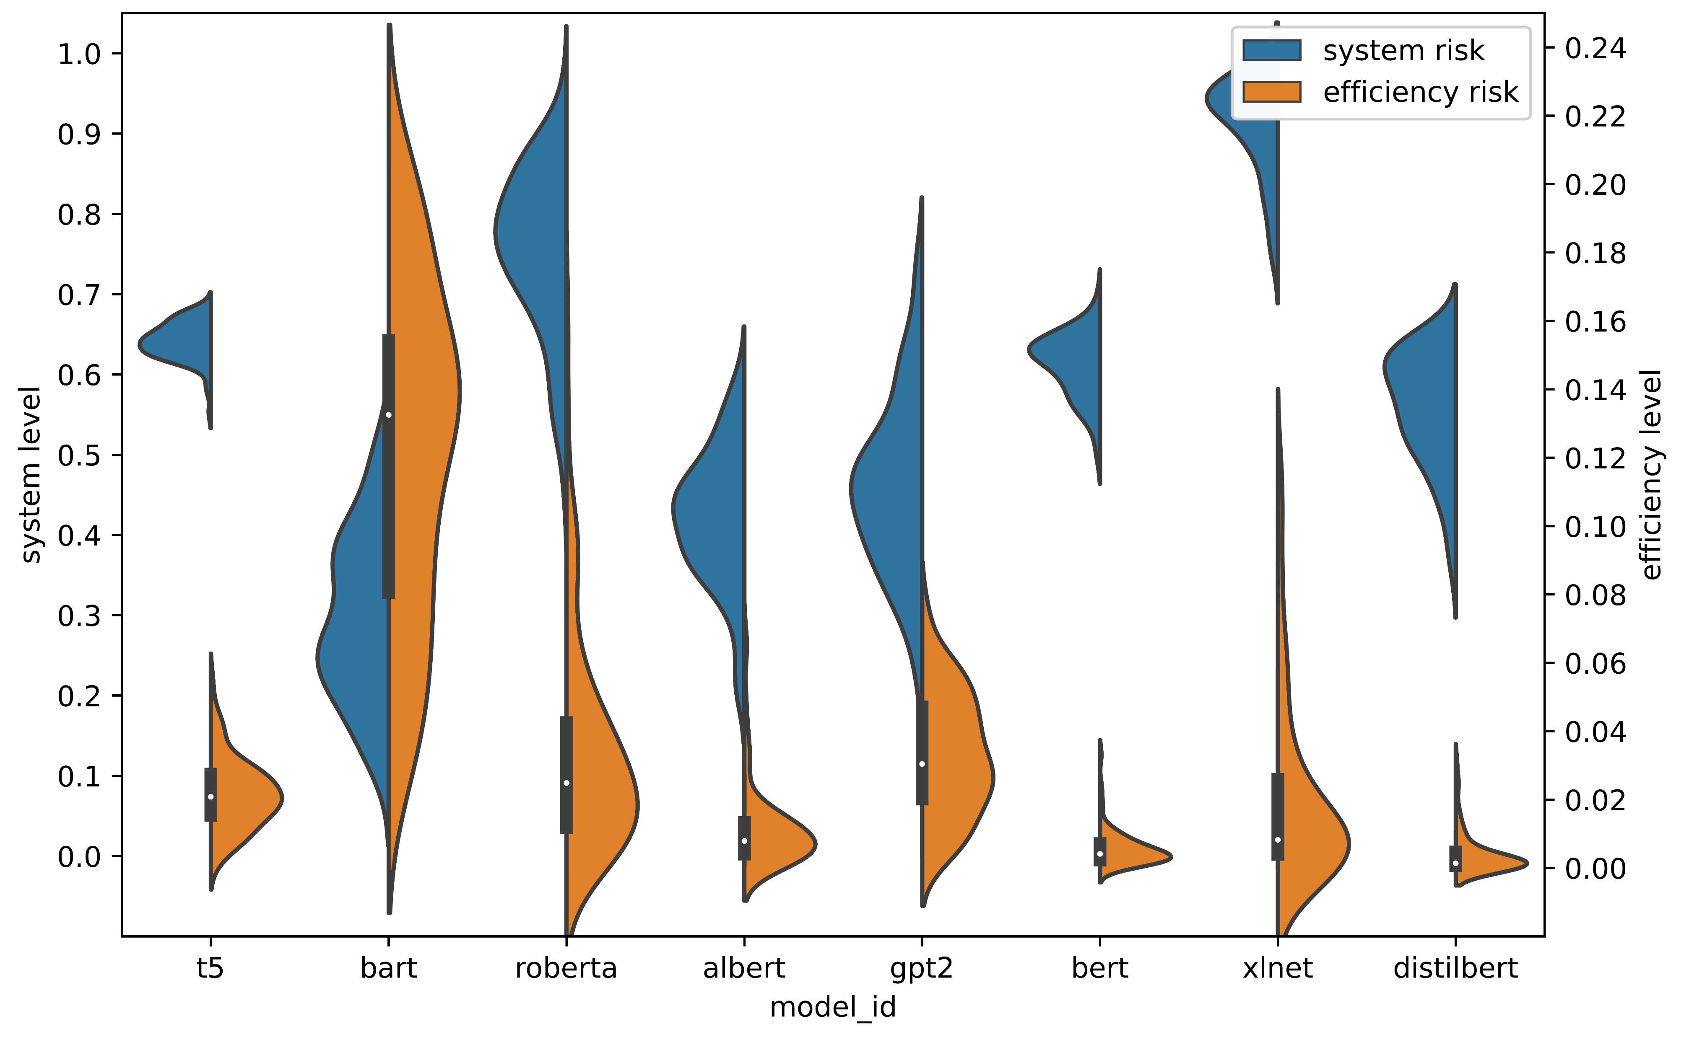
Managing discrimination in AI
(a) Gender
(b) Race
The violin plot for comparing the range and shape of system level distribution and efficiency level distribution under the topic of Gender and Race. Both system distribution and efficiency distribution are comparable across the topic and the discrimination criterion along the y-stick.
To effectively address AI discrimination, we should take a two-pronged approach that focuses on both bias and efficiency.
22

Slide 23

Future Work
Template Generalizability
How Learning Machines Itself Might Effect Its Inborn Discrimination Level
Learning Machines Other Than PLMs
23

Slide 24
Thank you for listening.

